Slide 1



LSUHSC-NO Health Policy Honors Program
Contributions to Promoting Evidence-Based Care to Louisiana Medicaid Members
LA Medicaid Private University Partnership Program (PUPP)
Research Team
Peggy A. Honoré, DHA, MHA
Patrick Bernet, PhD
Madeline DeGrange, MD
Xena Zhang, MD
Eva Mace, (MD Class of 2024)

Slide 2
Introduction
Policy Honors Program Goal
Enhances the curriculum for medical students who express intellectual curiosity about the impact of policy on individual and population health especially in disadvantaged populations
Build medical student expertise for eliminating inequities
Provide practical and theoretical knowledge to participate as physicians in the role that policy plays for improving the health of populations and to understand how policy influences the context in which healthcare is practiced
Experiences equip students for professional growth as physician leaders with skills to advance health system improvements through policy.
Aim is to use economic evaluations to generate evidence regarding LA Medicaid programs on:
Economic burden of maternal morbidity and mortality and policies in other jurisdictions to reduce disparities,
Effectiveness and cost efficiency of chronic disease management through nutrition,
Economic impact and health outcomes associated with Medicaid post-partum coverage
Aligns with PUPP Objectives:
Improving maternal and neonatal outcomes;
Improving health outcomes from the most common causes of morbidity and mortality with an emphasis on preventive health;
Understanding and reducing health disparities and improving health equity

Slide 3

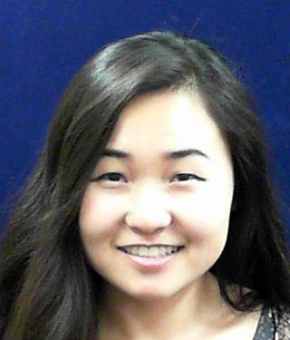

Introduction
The economic evaluations under PUPP enhance the analysis of LSUHSC-NO Health Policy Honors Program medical students who conduct policy analysis on health issues that impact Louisiana Medicaid costs, value, quality, equity, and patient outcomes.
Student |  | Project | Background
Madeline DeGrange, MD 2023 Mt Sinai |  | Economic evaluation to identify the economic burdens related to maternal mortality and morbidity. Nominated for the Sylvia R. Kelly Medical Scholarship for Health Equity. | Louisiana: Fifth-highest maternal mortality rate (39 per 100k births in 2021)
Xena Zhang, MD 2023 University of Miami |  | Analysis of Medicaid policies to address disparities by covering medically tailored meals for individuals with complex chronic conditions | 19% higher rates of obesity 44% higher rates of diabetes 83% more likely lacking healthy food access 58% more likely in poor/fair health
Eva Mace, MD, Class of 2024 |  | Assessment of the economic impact and health outcomes associated with Medicaid post-partum coverage | Postpartum coverage associated with better maternal health, increased use of contraceptives and increased use of preventative care services

Slide 4
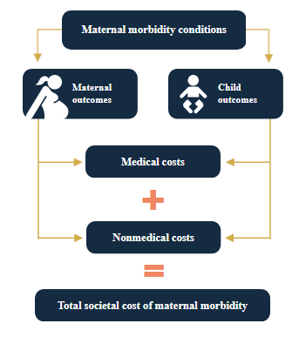
Methods: Maternal Mental Health
Study Design
Economic simulation model developed using baseline outcome probabilities and costs from nationwide statistics
Mathematica – Commonwealth Fund ¹⁻²
Meta study (n=50) that linked the cost of pregnancy outcomes, Untreated Maternal Mental Health Conditions (UMMHC) had an excess medical and societal economic burden of $32.3³
Values include mother and child through age 5
Untreated mental health conditions (UMMHC) are the diagnosis most-associated with adverse pregnancy and child outcomes⁴
Maternal mortality 10Xs more likely
Longer peripartum hospital stay
Preterm births 2.4Xs more likely with UMMHC
Cesarean section delivery more likely
Medical costs added from adverse pregnancy: 37% UMMHC 10% Hemorrhage
Increase childhood trauma (ACEs)
Behavioral and Developmental Disabilities (longest social tail spending)

Slide 5
Methods:
Maternal Mental Health
Analysis plan
Adjusted outcome probabilities, costs, # of pregnancies to state of LA and parish level.
Customized to measure outcomes within specific communities
How many Pregnancies
How many UMMHC
Adjusted risks to local conditions

Slide 6
Results:
LA Cost of Untreated Maternal Mental Health Conditions (UMMHC)

Slide 7
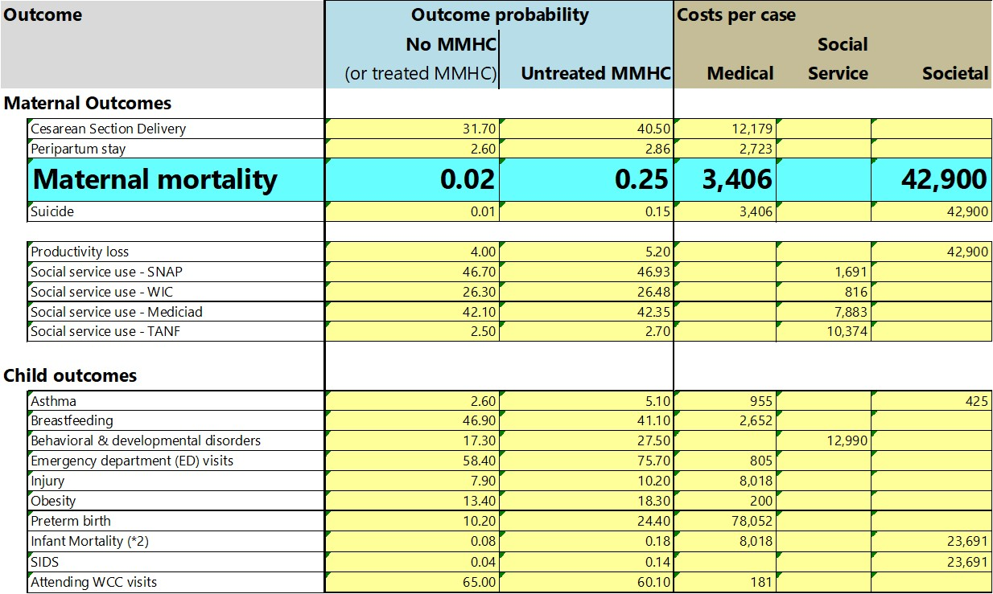
Results: Outcome Costs & Probabilities

Slide 8
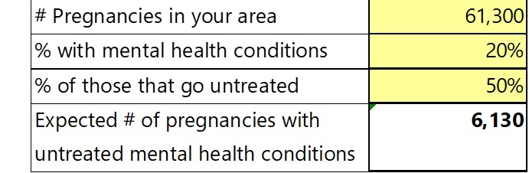
Results: Burden of UMMHC

Slide 9
Results:
What-If Analysis
Untreated reduced by 10%

Slide 10
Methods: Medically Tailored Meals (MTMs)
Economic model for MTM used baseline outcome probabilities and costs from a 2022 meta study that used Medical Expenditure Panel Survey⁵
Notes:
I did not mention N of all studies in meta study because it only comes to 2900.

Slide 11
Results: Medically Tailored Meals

Slide 12
Medicaid Relevant Conclusions
What can Medicaid do with this information.
Advance evidence-based Programs/Policies to reach MMCQS Aim of Smarter Spending⁶
Untreated maternal mental health is a driver of excess LA Medicaid spending
Potential substantial Medicaid savings if information is used to make the financial case for policies and strategies that reduce untreated maternal mental health (e. g., $1 of School-based Substance Abuse prevention saves system $18 [SAMHSA]); $1 in chronic disease prevention saves $5.18 [TFAH])
Strengthen policies for maternal mental health coverage by MCOs
Strengthen strategies for maternal mental health performance metrics
Policies to promote utilization of covered services
Promote 988 System as a strategy to reduce stigma⁷
Strengthen Community-based Org engagement/treatment also to reduce stigma⁸
Development of Parish/Community level reports on the UMMHC economic burden
Strategic Innovations to support lay positions (“navigators” and “peer support”)

Slide 13


Medicaid Relevant Conclusions
MTM - Reductions in health care utilization and expenditures -nationally 1.6million averted hospitalizations and cost savings of $12.6 billion
Medically Tailored Meals often covered ‘in lieu of’ more expensive meal preparation by home health workers.
Next steps
Complete postpartum expansion economic evaluation (Eva Mace-Policy Honors medical student)
Build website to host and curate Economic Tool http://www.publichealthfinance.org/
Engage stakeholders and additional Health Policy Honors students
Office of Women’s and Community Health
Caddo Parish March of Dimes analysis with focus on preterm births
MHSD Mental Health Navigator positions/education
Continue exploring best practice policy options

Slide 14
References
The costs of untreated maternal mental health conditions. https://www.mathematica.org/blogs/the-costs-of-untreated-maternal-mental-health-conditions
The High costs of Maternal Morbidity show why we need greater investment in Maternal Health. https://www.commonwealthfund.org/publications/issue-briefs/2021/nov/high-costs-maternal-morbidity-need-investment-maternal-health
O’Neil SS, Platt I, Vohra D, Pendl-Robinson E, Dehus E, Zephyrin L, Zivin K. Societal cost of nine selected maternal morbidities in the United States. Plos one. 2022 Oct 26;17(10):e0275656. https://journals.plos.org/plosone/article?id=10.1371/journal.pone.0275656
Julia Langham, Ipek Gurol-Urganci, Patrick Muller, Kirstin Webster, Emma Tassie, Margaret Heslin, Sarah Byford, Asma Khalil, Tina Harris,
Helen Sharp, Dharmintra Pasupathy, Jan van der Meulen, Louise M Howard, Heather A O’Mahen. Obstetric and neonatal outcomes in
pregnant women with and without a history of specialist mental health care: a national population-based cohort study using linked
routinely collected data in England. Lancet Psychiatry.
https://www.thelancet.com/journals/lanpsy/article/PIIS2215-0366(23)00200-6/fulltext
Hager K, Cudhea FP, Wong JB, et al. Association of National Expansion of Insurance Coverage of Medically Tailored Meals With Estimated Hospitalizations and Health Care Expenditures in the US. JAMA Netw Open. 2022;5(10) https://jamanetwork.com/journals/jamanetworkopen/article-abstract/2797397
Louisiana’s Medicaid Managed Care Quality Strategy. March 2023. Bureau of Health Services Financing. https://ldh.la.gov/assets/docs/MQI/MQIStrategy.pdf
Eylem, O., de Wit, L., van Straten, A. et al. Stigma for common mental disorders in racial minorities and majorities a systematic review and meta-analysis. BMC Public Health 20, 87. (2020). https://doi.org/10.1186/s12889-020-08964-3
8. Policy Center for Maternal Mental Health. State Opportunities. https://www.2020mom.org/report-card-methodology

Slide 15

Thank You for this Opportunity
Peggy A. Honoré , DHA, MHA
phono1@lsuhsc.edu
Patrick Bernet, PhD
pbernet@outlook.com
Health Policy Honors Program https://sph.lsuhsc.edu/health-policy-honors-program/

