Slide 1

Understanding Breast Cancer Screenings and Disparities for AmeriHealth Caritas Members in Louisiana
Adrienne Murphy
Louisiana State University Health Sciences Center New Orleans
School of Medicine, Class of 2023
AmeriHealth Caritas Louisiana Medical Intern
March 7th ,2023

Slide 2
Breast Cancer: Epidemiology
Breast Cancer MCC among women accounting for 29% of all new cancers in women
2.3 Million cases of BC Dx globally per year
80% of patients with BC aged 50 or higher
5th cause of Cancer Related death with
Survival heavily dependent of stage , molecular subtype and Income
Women in high income brackets have higher rates of survival vs Low-income brackets

Slide 3
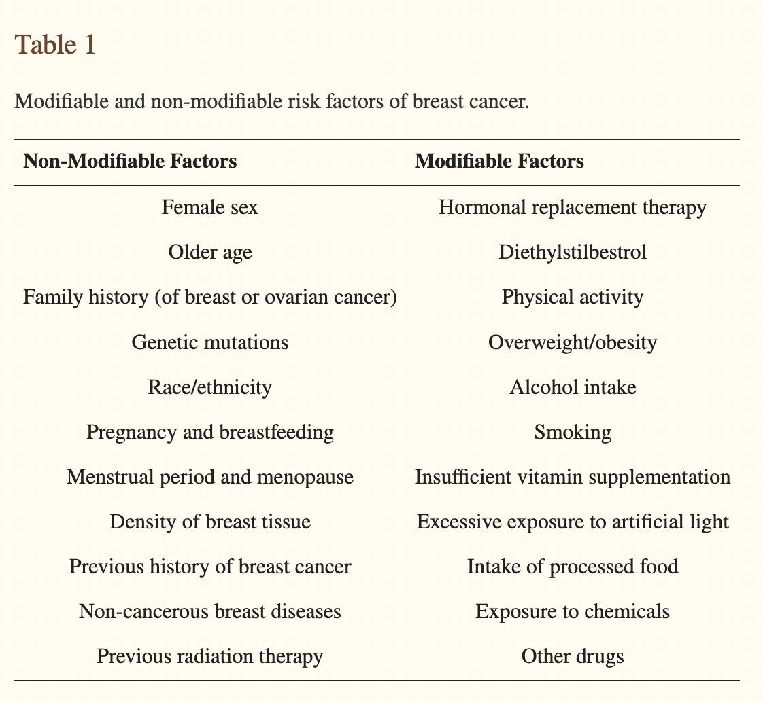
Risk Factors
Broken down in to Modifiable versus Non-Modifiable

Slide 4
Breast Cancer Facts
1 in 8 U.S. women will get Breast Caner
BC most frequently Diagnosed Cancer in Louisiana Women
Black Women in Louisiana Dx more frequently and more likely to die from BC than the national average
  That combined with Lack of care are two main reason LA Death Rate from Breast Cancer is high
If you catch BC early, the survival is close to 100% even at Stage 3 survival is 72%
BCS (mammograms) are coverall by all insurance plans

Slide 5
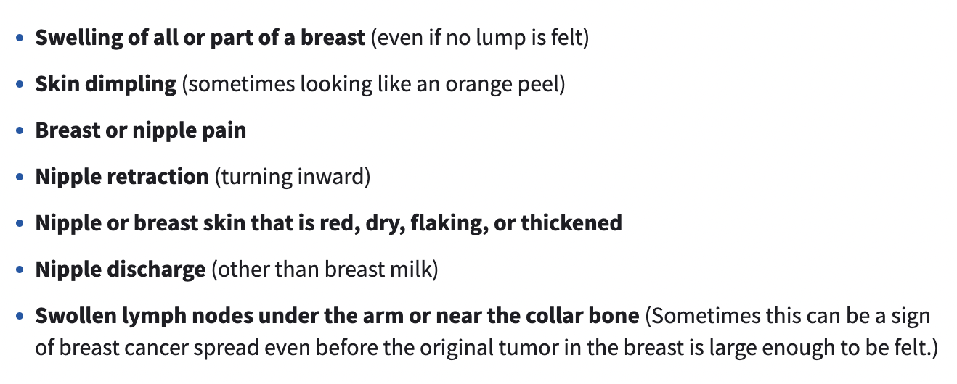
Breast Cancer Signs and Symptoms
American Cancer Society Outlines the Following:
ANY NEW LUMP OR MASS as the most common symptom of BC
MC sx of BC: Any New lump or mass

Slide 6
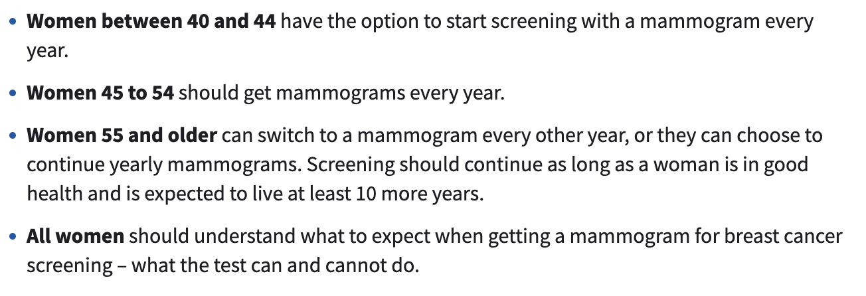
ACS Breast Cancer Screening Guidelines: Average Risk

Slide 7
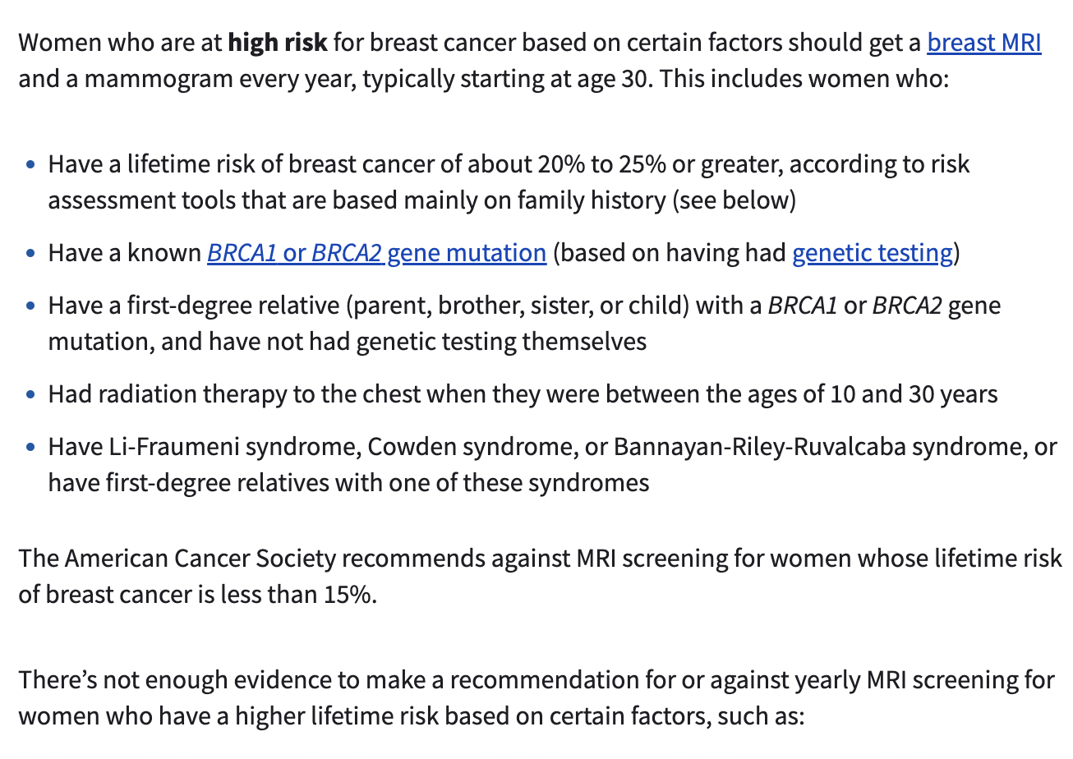
ACS Breast Cancer Screening Guidelines: High Risk

Slide 8
LA Breast and Cervical Health Program
LBCHP program provides no-cost mammograms to LA women who qualify based on age, income, and insurance status
Screenings offered for:
  Women aged 40-64 at regular intervals
  Any women, of any age with BC sxs or a strong Family History
  Even women with insurance who may not be able to afford all screening cost can attain assistance with LBCHP

Slide 9
Disparities in Race in Dx TNBC of ACLA Members: 2021

Slide 10
Disparities in Breast Cancer Screenings Exam vs Diagnosis in ACLA Members: 2021
70%

Slide 11
ACLA Members Unspecified Breast Neoplasm by Race: 2021

Slide 12
What does the ACLA Data tell us?
Black ACLA members are more likely to be diagnosed with Breast Cancer
  70% of those diagnosed will have TNBC
Black ACLA members less likely to receive diagnostic study within three months from finding “unspecified breast neoplasm”
White ACLA members have lower percentages of Breast Cancer and also higher percentages receiving diagnostic study within 3 months

Slide 13

ACLA Breast Cancer Recommendations based on 2021 Data
  More Education to providers and ACLA Members stressing the importance of timely Screenings based on age and risk factors
  Distribute educational materials at community events about breast cancer and timely screening equating survival
  Provider Follow-ups on patients appointments with “unspecified breast neoplasm” for diagnostic imaging
  System wide notification within ACLA to notify members by phone, mail and Text when overdue for Breast Cancer Screenings/Appointment Follow-up
  Provide ACLA providers with monthly reports of members overdue and members with outstanding diagnostic imaging after reveling a neoplasm
  Incentive Programs for ACLA members who are uptodate on screening exam ex:Breast, cervical etc
  Addressing Race disparities will require understanding SES of ACLA members particularly black members
  Social Media Campaigns to bring more awareness amongst racial groups effected

Slide 14
Thank You
Will Take any questions?

Slide 15
Resources
https://gis.cdc.gov/Cancer/USCS/?CDC_AA_refVal=https%3A%2F%2Fwww.cdc.gov%2Fcancer%2Fdataviz%2Findex.htm#/AtAGlance/
https://www.breastcancer.org/types
https://www.nationalbreastcancer.org/types-of-breast-cancer/
https://www.cancer.org/cancer/breast-cancer/screening-tests-and-early-detection/breast-cancer-signs-and-symptoms.html
https://louisianacancer.org/cancers/breast-cancer/

