Slide 1
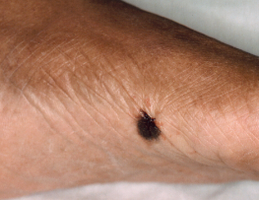
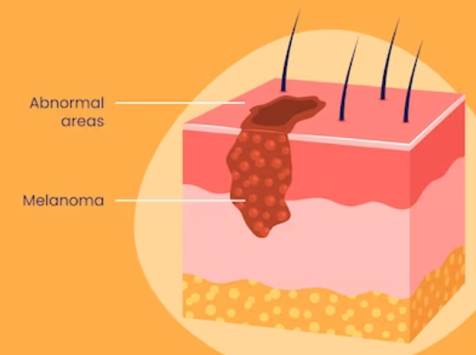



A Focus on Skin:
Disparities in Melanoma Diagnosis and Treatment
and Recommendations for Disease Prevention in ACLA Members
Ada Tusa
Louisiana State University Health Sciences Center
New Orleans
School of Medicine, Class of 2023
AmeriHealth Caritas Louisiana Medical Intern
March 8, 2023

Slide 2




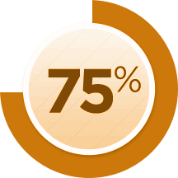

Why does melanoma matter?
Skin cancer is the most common form of cancer in the US.
More than 1 million people are living with melanoma, and 1 person dies of the disease every hour.
1 in 5 Americans will develop skin cancer by age 70.
Melanoma accounts for
of mortality from skin
cancer.
Melanoma cases have doubled over the last 3 decades.
The treatment of skin cancer in the US costs $8.9 billion annually.
BUT when detected early, the 5-year survival rate is 99%.
Notes:
So why does melanoma matter?
Skin cancer is the most commonly diagnosed cancer in our country, and 1 in 5 americans will develop it by age 70. Not only is it common, but it is costly - skin cancer is associated with about $9 billion in healthcare costs each year.
Melanoma is the deadliest form of skin cancer, as 1 person dies of the disease every hour, and it accounts for 75% of skin cancer mortality.
And, Melanoma cases are on the rise, but, when detected early, the 5year survival rate is 99%

Slide 3
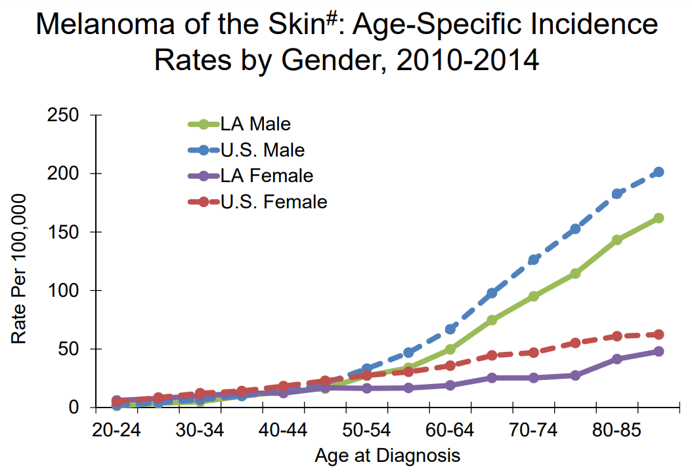

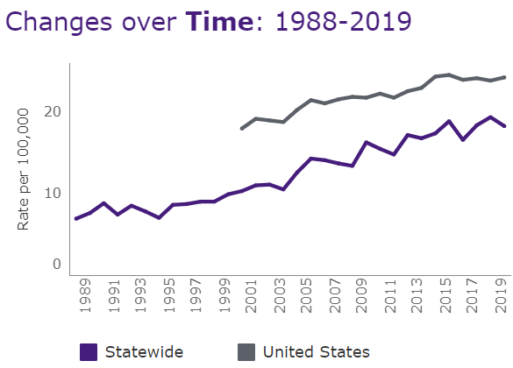

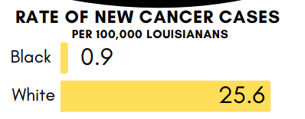
Melanoma in Louisiana
Age and Gender
Male
50
Female
…and Incidence Rate is increasing over time
Race
Notes:
In our state of louisiana, about 1000 cases are diagnosed each year, and the incidence rate is climbing.
Regarding demographics, incidence increases with age, and over 50 it affects more males than it does females.
Regarding race, melanoma is more common in those with fair skin

Slide 4

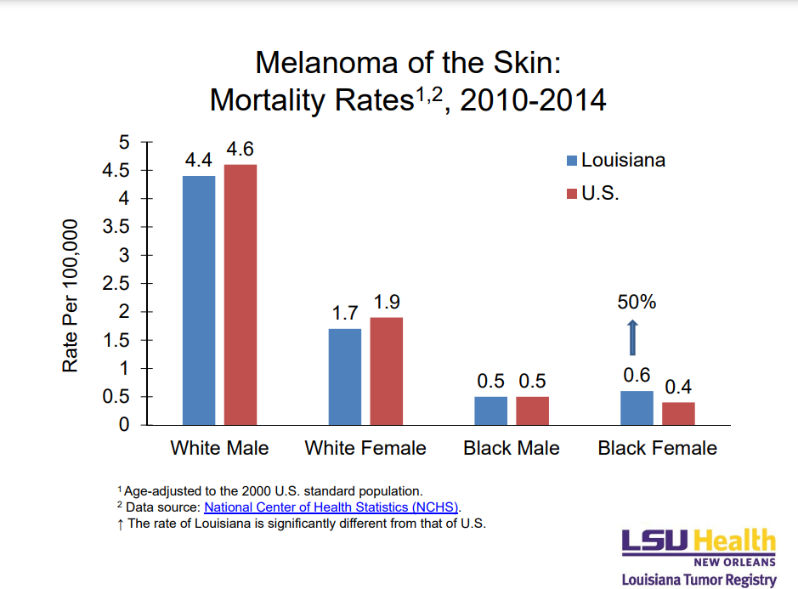
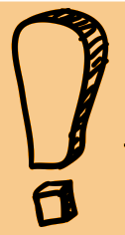
Racial Disparity in Louisiana
White patients are 25% more likely to survive melanoma compared to Black patients.
In LA, mortality in Black females with melanoma is 50% higher than all of the US.
Notes:
BUT, despite this prevalence in white patients, there are disparities in the black population. Minorities are consistently diagnosed at later stages and suffer worse melanoma specific survival.
So white patients are 25% more likely to survive melanoma than their Black counterparts.
Also, this graph shows the increased mortality rate of black females with melanoma in louisiana compared to those nationwide

Slide 5
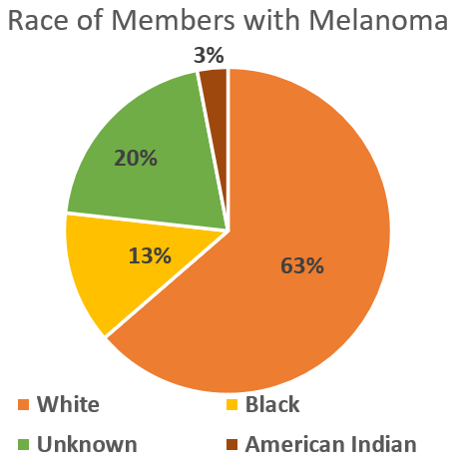
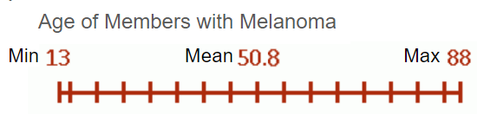
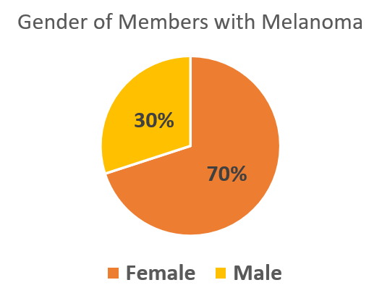
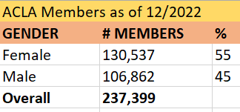
ACLA Data (2022)
n = 30 members with diagnosis of malignant melanoma who received healthcare services in 2022
Mean age is younger than most melanoma patients, but 82% of ACLA members are < 50 yo.
as of 12/31/22
ACLA melanoma gender does not mirror LA/US melanoma trend (but this trend is > 50 yo)
Race of LA Medicaid Members 2021
White | Black | American Indian
64.8% | 27.6% | 0.3%
Notes:
I studied a sample of ACLA members who had diagnoses of malignant cutaneous melanoma and also received healthcare services last year. I understand this is a small sample size, but we had some interesting findings. The racial distribution of these members mirrors that of ACLA members as a whole, and it is what we would expect since melanoma mostly affects whites. The mean age of this sample is relatively young at 50.8, compared to the trends we see with incidence rate increasing dramatically over 50 years of age, but the ACLA members are young, with 82% of members younger than 50. Lastly, regarding gender, we are seeing much more cases in females than males, which is not completely unexpected since the male predominance trend is usually seen after age 50.

Slide 6
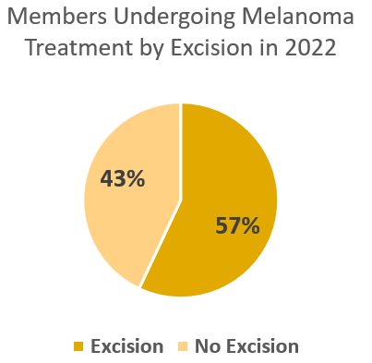
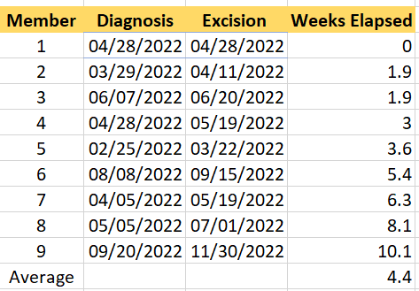

ACLA 2022 Treatment
Time from diagnosis to treatment:
Recommendation for time from diagnostic biopsy to treatment with excision is 4-6 weeks.
2022 study: Delay beyond 1 month is associated with worse overall mortality.
Standard of treatment is surgical excision.
*Unknown if patients moved away or expired, or if first dx or tx occurred out of 2022 window
*Also some of the members with metastatic disease underwent chemo/radiation instead.
Member 7:
Member 8:
Member 9:
58 yo UM from Region 6 with Hx DM, HTN, CAD, with metastatic dz + chemo
24 yo WF from Region 4 with complex graft on face
13 yo WF from Region 8
Notes:
I also looked at melanoma treatment in these patients. Because the gold standard of treatment is surgical excision, i focused on this, and we can see that a little more than half of the cohort was treated with excision. Id like to mention that there were many unknowns with this sample, and it is very possible that some of the patients received treatment before or after 2022, or they could have moved away, or expired. Also, some of the patients with metastatic disease underwent chemo or radiation instead.
Time from diagnosis to treatment is an important prognostic factor. The recommendation for time from diagnostic biopsy to treatment with excision is 4-6 weeks and one study showed that any delay beyond 1 month is associated with worse overall mortality.
Some of these dates were missing from our claims data, but i found that on average our members are undergoing excision within the 4-6 week window. Those who did not, i identified here. Member 7 had multiple medical comorbidities as well as metastatic disease requiring chemo. And members 8 and 9 were relatively young, with 8 requiring a complex graft on her face, and member 9 being a minor.

Slide 7
Recommendations and Considerations
These interventions can help prevent not only melanoma but also other forms of skin cancer.
Notes:
Now id like to shift the focus to some action items for us to consider. I want to emphasize that these interventions can help prevent multiple forms of skin cancer, not only melanoma. And, primary prevention of disease at a young age will be more effective than secondary prevention with screening.

Slide 8
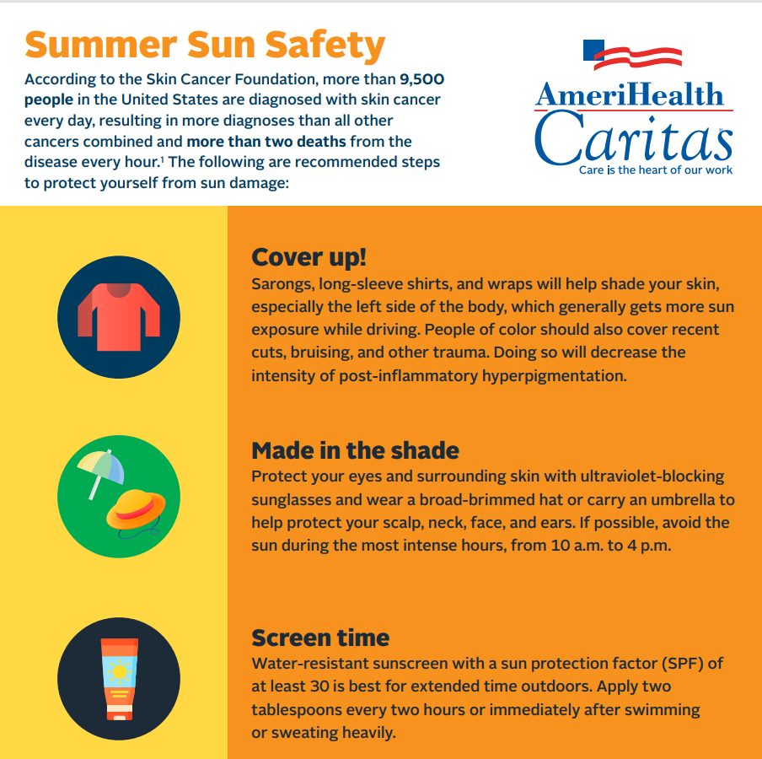
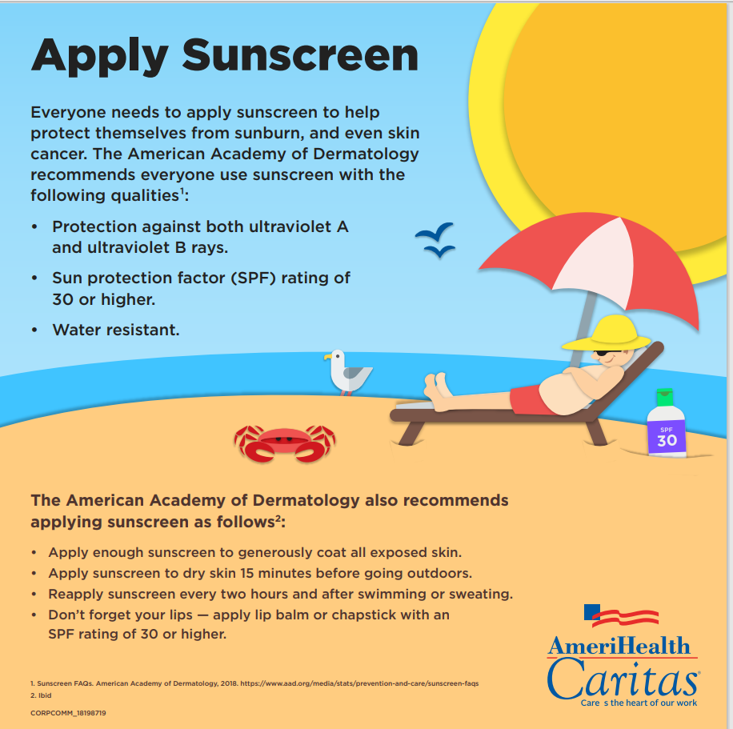
ACLA Infographics
Great evidence-based recs
Notes:
To start, I found these two infographics on the amerihealth caritas website, which contain accurate and up to date, evidence-based recommendations focused on primary prevention. Things such as wearing a wide-brimmed hat, sunglasses, SPF 30+ and reapplying every 2 hours, and avoiding direct sunlight from 10am to 4pm are all dermatologist-recommended interventions.

Slide 9
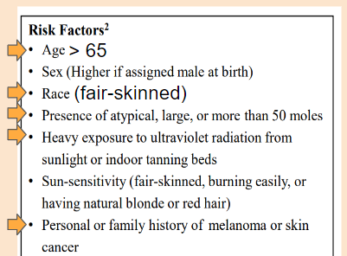
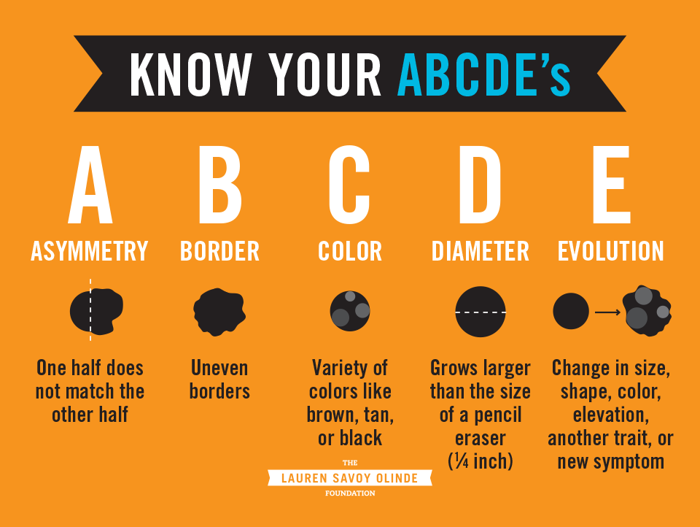
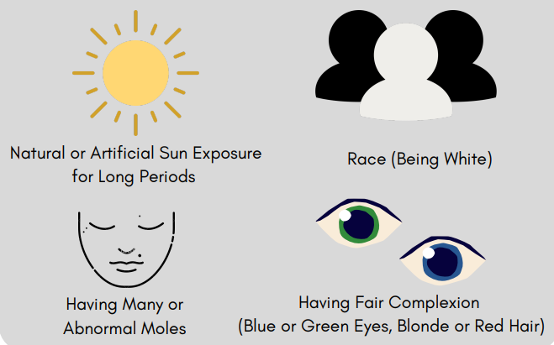
Ideas for new melanoma
infographics:
ABCDEs and Risk Factors
Notes:
Other information that would be helpful to add for members would be the ABCDEs of melanoma and education on modifiable and nonmodifiable risk factors. A 2016 study showed most melanomas were self-detected by the patient, so it is important to encourage self-exams as secondary prevention of disease.

Slide 10



Proposed ACLA Interventions
*Primary > secondary prevention
Addressing disparity: Where to focus our efforts
Younger patients (<50) and parents of young children - can help with primary prevention, and we had two young patients experience delays in treatment
Black females (higher mortality compared to black females nationwide)
All black patients (higher mortality, less disease awareness, more advanced stage at diagnosis)
Males over 50 (much higher incidence rate than females in this age range)
Future directions
Explore delays in treatment
Explore stage and histological subtype at diagnosis
Modify data inclusion to multiple years
Brochures or infographics to be published in online “Healthy Now” newsletter and Provider Resources site
Things to add:
ABCDEs of melanoma
Risk factors for skin cancer (modifiable and nonmodifiable)
Include pictures of skin of color in educational materials. Include information on examining sun-protected areas in these patients - palms, soles, mouth, and nails.
Start young
Discourage tanning beds.
Spring and summer months: social media and text message campaigns about sun safety and self-exams
Loss to follow up:
Appointment reminders for all and especially follow-up appointments
Automated text reminders to schedule annual skin exams for at-risk patients
Notes:
Getting into specifics, I understand that skin cancer is not a priority item for ACLA, but i wanted to discuss some ideas that may be a good starting point for raising awareness and addressing those at risk.
Again, primary prevention will be much more effective than secondary with skin cancer, as screening is not currently recommended for the general population by USPSTF
The infographics i shared could be posted online in the Healthy Now newsletter and made available to providers for them to either display or distribute to members.
It would be helpful to add some of these other topics, like i mentioned the ABCDEs and risk factors, and more information for patients with skin of color, since melanoma often presents differently there, and an emphasis on starting young - excessive sun exposure and blistering sunburns during childhood are a known risk for development of melanoma later in life.
During the warmer months, social media and text message campaigns can help spread awareness about sun safety and conducting self-exams.
Because loss- to follow up is a prognostic concern with treatment of melanoma, appointment reminders via text or email could be helpful. And scheduling reminders can be sent to patients who are due for their annual full body skin exams.
I say to focus our efforts on these demographics, based on what we know about melanoma and what i found in last year’s data. Younger patients are important to target because of primary prevention, and because we saw delays in treatment in some of our younger members. Black females are at risk for higher mortality in our state, all black patients are at risk for worse outcomes, and males over 50 experience the highest incidence rate state-wide.
If anyone would like to explore this topic further, i have some future directions listed here. Id like to explore delays in treatment. although Most of the ACLA members from 2022 were treated within the recommended time window, we still worry about loss to follow up and advancement of disease. So we need to identify barriers to tx and ways to improve.
It would be helpful to explore the stage and histological subtype at diagnosis, to identify which demographics are presenting with more advanced or aggressive disease and who could benefit from more screening
And lastly, i would modify the data inclusion criteria to encompass multiple years, which would identify more patients and hopefully better capture the date of initial diagnosis and date of excision, since we had so many patients from my sample with unknown clinical timelines.

Slide 11
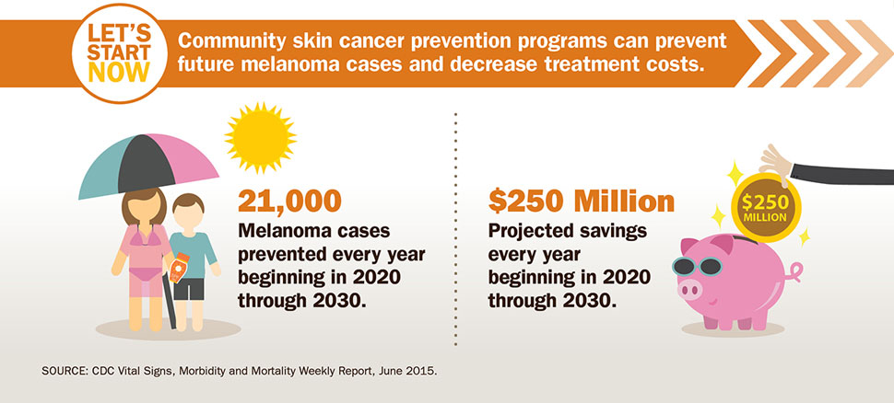
CDC Predictions of Intervention Benefits:
These interventions can help prevent not only melanoma but also other forms of skin cancer!
Notes:
To conclude, The CDC predicts that skin cancer prevention programs can help prevent 20,000 cases and save 250 million dollars in the next decade. And remember that these interventions can help prevent many forms of skin disease in our population, not only melanoma.

Slide 12
References
1. Statistics. Public Health. Accessed March 1, 2023. https://sph.lsuhsc.edu/louisiana-tumor-registry/data-usestatistics/statistics/
2. American Cancer Society. Facts & Statistics. Published 2020. https://cancerstatisticscenter.cancer.org/#
3. United States Preventive Services Taskforce. www.uspreventiveservicestaskforce.org.
4. Melanoma clinical guideline. www.aad.org. https://www.aad.org/member/clinical-quality/guidelines/melanoma
5. Swetter SM, Tsao H, Bichakjian CK, et al. Guidelines of care for the management of primary cutaneous melanoma. Journal of the American Academy of Dermatology. 2019;80(1):208-250. doi:https://doi.org/10.1016/j.jaad.2018.08.055
6. Cheraghlou S, Agogo GO, Girardi M. System-level variations in treatment delay for nonmetastatic melanoma. Journal of the American Academy of Dermatology. 2019;81(6):1399-1401. doi:https://doi.org/10.1016/j.jaad.2019.04.038
7. Kolla AM, Seixas A, Adotama P, et al. A health equity framework to address racial and ethnic disparities in melanoma. Journal of the American Academy of Dermatology. 2022;87(5):1220-1222. doi:https://doi.org/10.1016/j.jaad.2022.05.070
8. PhD JN. Delaying Treatment for Melanoma Increases Mortality Risk. Oncology Nurse Advisor. Published September 8, 2022. Accessed March 7, 2023. https://www.oncologynurseadvisor.com/home/cancer-types/melanoma/delaying-treatment-melanoma-mortality-risk-treatment/
9. Dawes SM, Tsai S, Gittleman H, Barnholtz-Sloan JS, Bordeaux JS. Racial disparities in melanoma survival. Journal of the American Academy of Dermatology. 2016;75(5):983-991. doi:https://doi.org/10.1016/j.jaad.2016.06.006
10. Geller AC, Swetter SM, Oliveria S, Dusza S, Halpern AC. Reducing mortality in individuals at high risk for advanced melanoma through education and screening. Journal of the American Academy of Dermatology. 2011;65(5):S87.e1-S87.e9. doi:https://doi.org/10.1016/j.jaad.2011.05.045
12. Preventing Melanoma infographics | VitalSigns | CDC. www.cdc.gov. Published February 12, 2019. https://www.cdc.gov/vitalsigns/melanoma/infographic.html
13. CDC - Newsroom Significant Knowledge Gaps About Melanoma Skin Cancer. www.cdc.gov. Accessed March 7, 2023. https://www.cdc.gov/media/pressrel/skinca1.htm

Slide 13

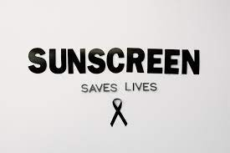
Acknowledgments
Thank you!
Questions?
Dr. Gregory Randolph
Dana Smith
Renee’ Wells and Rhonda Baird
LaKaley Tillery and ACLA Data Services
Dr. Rodney Wise
Dr. Pegge Honore
Lekitha Gregory and ACLA Onboarding
Patricia Price

Slide 14
Other Informational Slides to Follow….

Slide 15

Other Considerations
Health policy
Community Guide: “Multicomponent community-wide interventions”
Individual-directed strategies, mass media campaigns, and environmental and policy changes across multiple settings
Increase shade at playgrounds, public pools, parks, etc
Promote sun protection in recreational areas, including selling hats, sunscreen, and sunglasses.
Children: Push for recess areas to have adequate shade. Restrict the availability and use of indoor tanning by minors.
Enforce provision of sun protective clothing, sunscreen, and adequate shade for outdoor workers.
NIH National Cancer Institute’s Sun Safety Evidence-Based Programs Listing: Program materials, implementation guides, and ideas
Encourage employers, childcare centers, schools, and colleges to teach employees and students about sun safety and skin protection.
Providers
Screen at-risk patients (secondary prevention) (USPSTF does not recommend screening all pts)
Primary care providers have major role
Behavioral counseling, especially high-risk patients and those who work or play outside (primary prevention - USPSTF Grade B/C)
Providers to teach patients about risk factors and ABCDEs of melanoma
Educate about and focus on skin of color. Patients with SOC are less likely to be counseled about skin cancer.
Ask POC about skin irritation/tenderness after sun exposure rather than asking about redness, peeling, or other changes
Encourage sunscreen sample distribution
Medical records
Emphasize importance of accuracy and specificity in physician documentation (many claims codes with “unspecified body site”)
Educate providers on importance of reporting cases to LA tumor registry
Time to treatment
Encourage providers to call and follow up on patients that no-show after biopsy
Refer concerning cases to dermatology. Previous work with a Medicare cohort revealed that patients who receive their biopsy and surgery by dermatologists have a lower risk for a delay in treatment

Slide 16
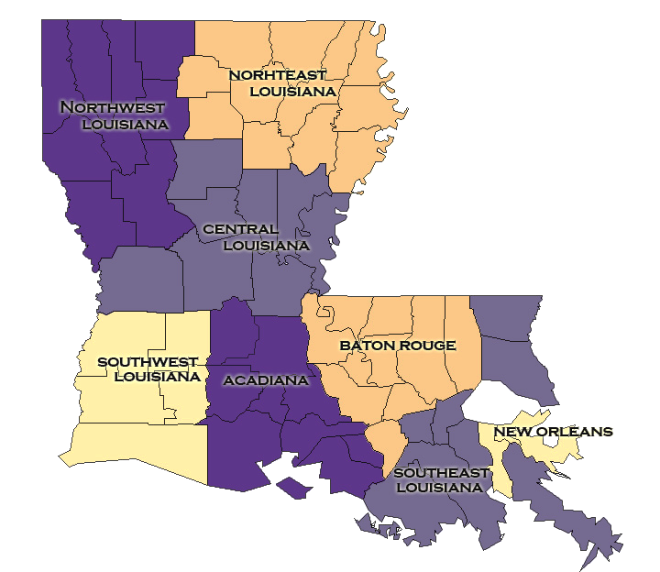
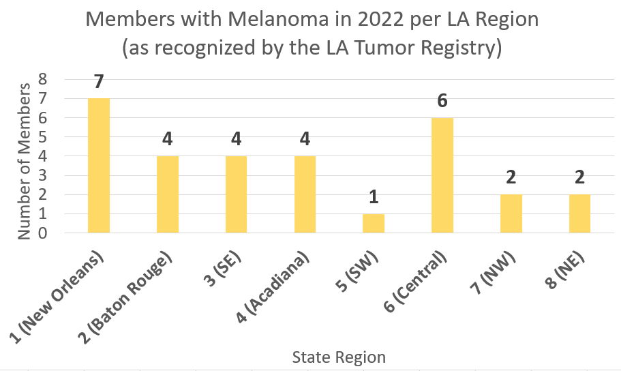
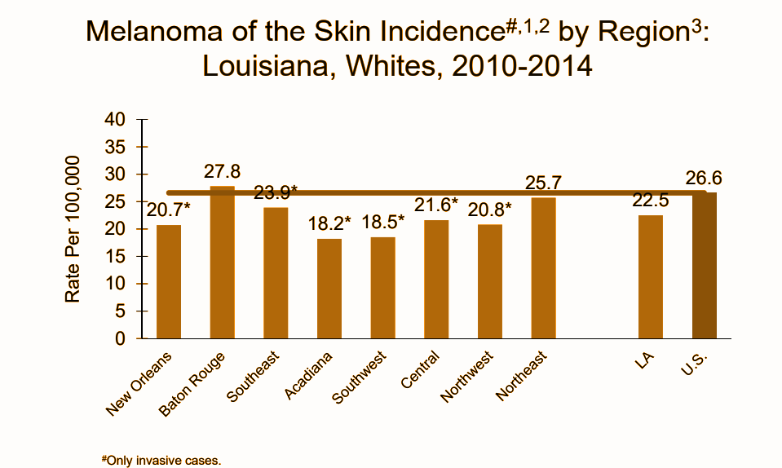
ACLA 2022 Data: Member Regions
BR (Region 2) with rates above national average! But not seen in our data

Slide 17
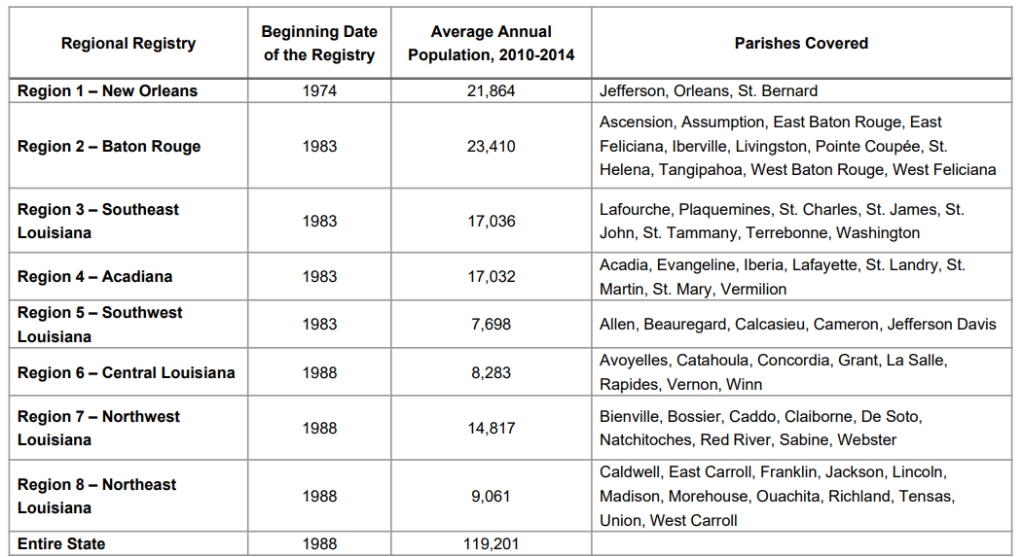

Slide 18
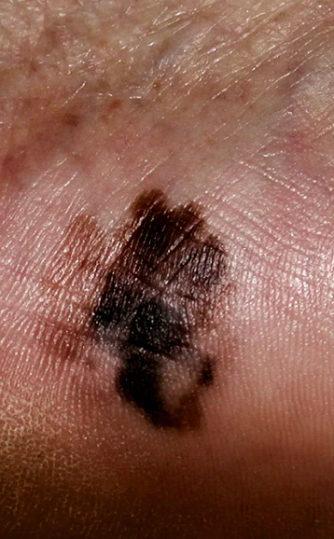
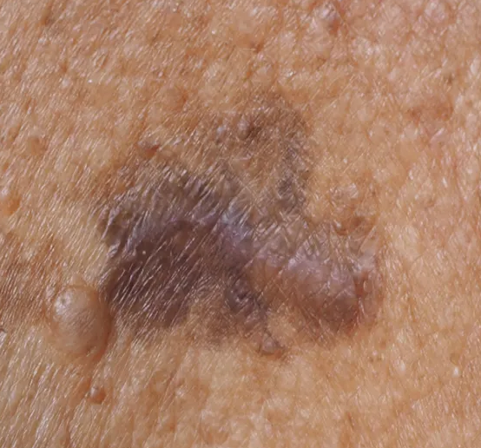
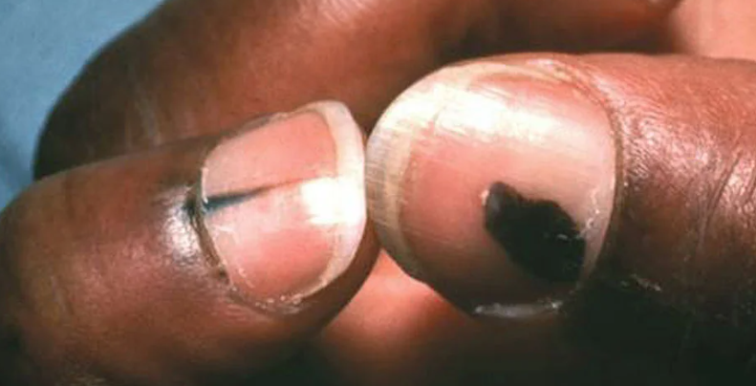
Melanoma in Black patients
Check hands and feet!
People with darker skin have higher rates of melanomas on skin not exposed to the sun. They also are more likely to have melanomas on mucous membranes, like the:
eyes
mouth
genitals
Additionally, melanomas can be found:
under the nails
on the soles of the feet
between the toes

Slide 19
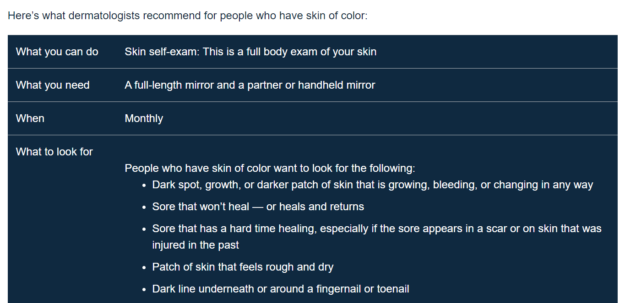
Skin cancer self-exams in patients with skin of color

Slide 20
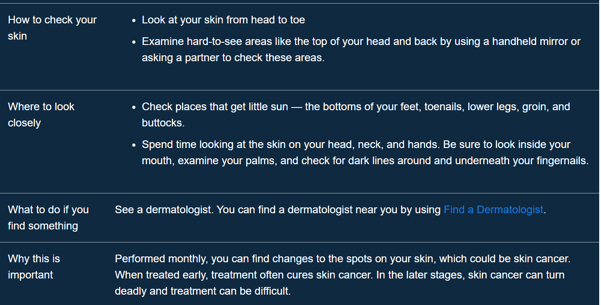
Skin cancer self-exams in patients with skin of color

Slide 21
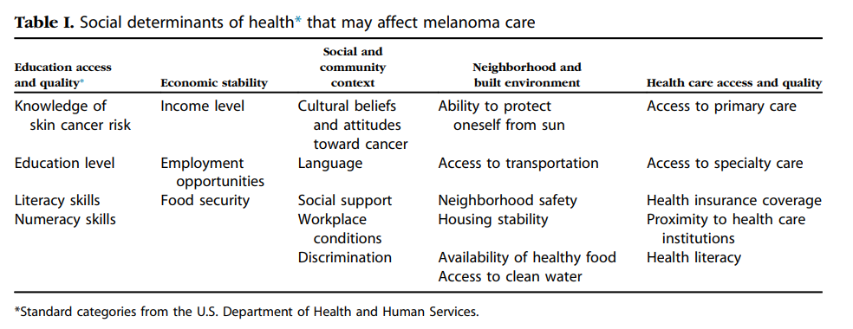
Notes:
Move to credits

