Slide 1
Improving Cervical Cancer Screening Rates for AmeriHealth Caritas Louisiana
Members
Karla Martin
Louisiana State University Health Sciences Center New Orleans
School of Medicine, Class of 2023
AmeriHealth Caritas Louisiana Medical Intern
November 18, 2022

Slide 2
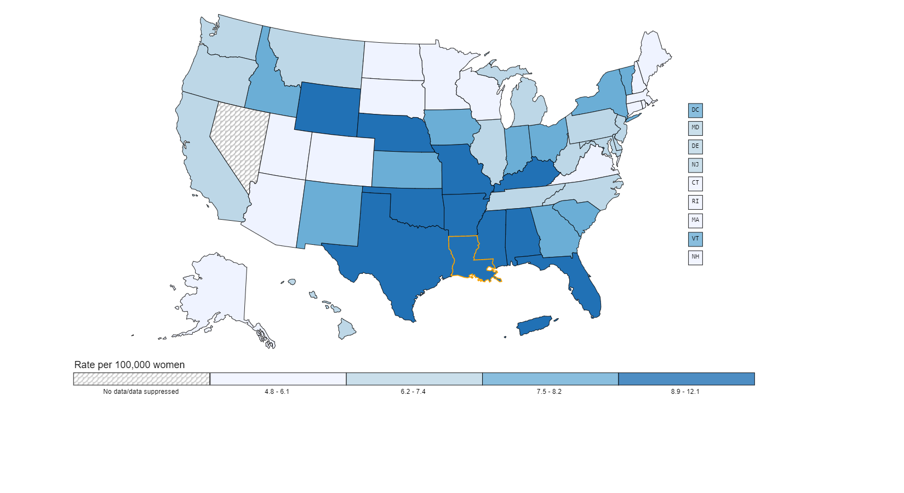
Background
Cervical cancer is the 4th most common cause of cancer among women globally.
In the US each year:
  ~ 12,000 women are diagnosed with cervical cancer
  ~ 4,200 women die from the disease
Cervical cancer is the most common HPV-related disease.
  HPV infection is responsible for 90-95% of cervical cancers
HPV vaccination, screening, and treatment of pre-cancerous lesions can help prevent cervical cancer.
Incidence Rate of Cervical Cancer USA, 2019 | Incidence Rate of Cervical Cancer Louisiana, 2019
7.5 per 100,000 women | 9.0 per 100,000 women

Slide 3
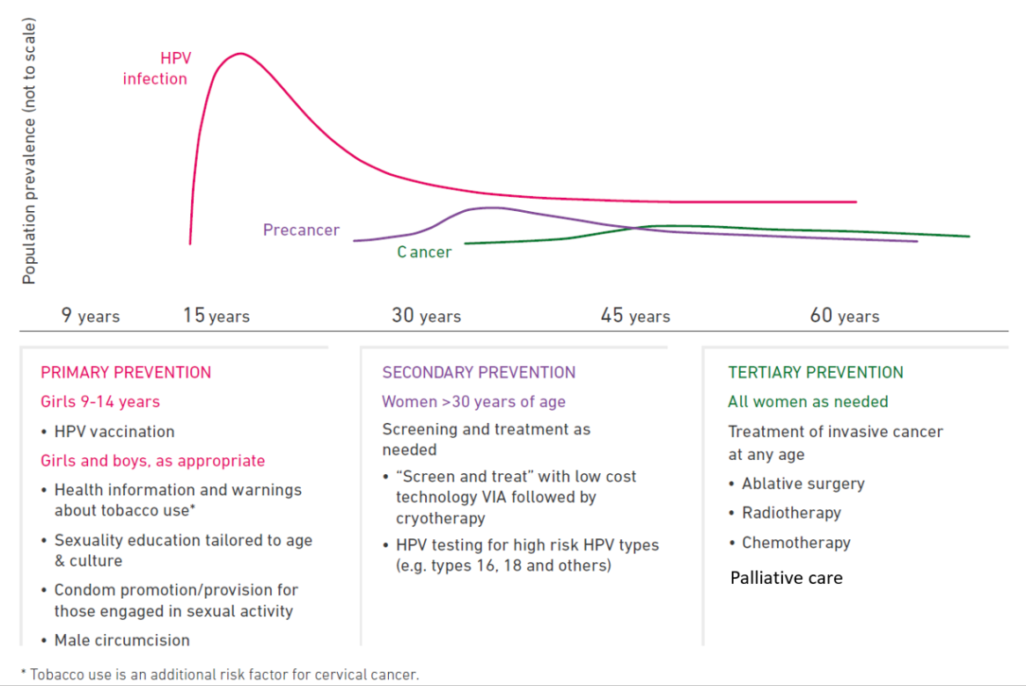

The Natural History of Cervical Cancer and
Current Strategies for Prevention and Control
Primary Prevention
Women (ages 21 – 65)
Aged 21 – 29: cytology alone every 3 years
Aged 30 – 65: Any one of the following:
  Cytology alone every 3 years
  hrHPV testing alone every 5 years
  hrHPV testing and cytology every 5 years
Secondary Prevention
All women as needed
Treatment of invasive cancer at any age and palliative care
Ablative surgery
Radiotherapy
Chemotherapy
Palliative Care
Females and Males
  HPV vaccination (ages 11- 12 (9 -26))
Health information and warnings about tobacco use
Sexuality education tailored to age & culture
Condom promotion/provision for those engaged in sexual activity
Male circumcision
Tertiary Prevention
Notes:
Comprehensive cervical cancer control includes primary prevention (vaccination against HPV), secondary prevention (screening and treatment of pre-cancerous lesions), tertiary prevention (diagnosis and treatment of invasive cervical cancer) and palliative care.

Slide 4

Healthy Louisiana
Medicaid Managed Care Program
Performance Measures
Aim | Goal | Objective | Healthy Louisiana Measure | Measure Description | Incentive-Based Measure?
Healthier People, Healthier Communities. Improve the health of Louisianians through evidence-based prevention and treatment interventions that address physical, behavioral health, and social needs. | Goal 4: Promote wellness and prevention. | Improve cancer screening | Cervical Cancer Screening | Percentage of women 21 – 64 years of age who were screened for cervical cancer: Women 21 – 64 who have had cervical cytology performed during the current MY or within the last 2 MYs Women 30 – 64 who have had cervical cytology/hrHPV contesting during the current MY or within the last 4 MYs
 | Goal 6: Improve population health and address health disparities. | Stratify key quality measures by race/ethnicity and rural/urban status and narrow health disparities. | Measures for stratified data: Pregnancy Child Adult: colorectal screening, cervical cancer screening, HIV viral load suppression Behavioral Health

Slide 5
Program Goals
Increase the rate of eligible members who have been appropriately screened for cervical cancer.
Increase HPV vaccination rates.
Increase early detection of cervical cancer.
Decrease the incidence of advanced cervical cancer while reinforcing the importance of preventative health screenings and immunizations.

Slide 6
CCS: Past and Present
49.66%
HEDIS MY 2022
YTD Rate
(Includes claims through 09/30)
49.40%
HEDIS MY 2021
Y/Y Rate
56.72%
Predicted Final
HEDIS MY 2022 Rate
59.12%
HEDIS MY 2022
NCQA’s Quality Compass National 50th %tile Rate
(Target Objective)
60.44%
HEDIS MY 2022
2.0 % Improvement Goal
(Improvement Objective)
YTD and projected data suggest a low likelihood that either of the
QI measures for CCS will be met by ACLA for MY 2022.

Slide 7
What Do We Know?
Current Strategies, Interventions, Barriers & Challenges
Strategies and Interventions
Member and Provider Education
Student Wellness Survey
Social Media and Text Message Campaigns
Member and Provider Incentives
  Members: CARE Card - $10 for CCS
  Providers: Performance ($$) Incentives
Community and Clinic Partnerships
  Iberia Comprehensive Community Health Center
  Feist-Weiller Cancer Center Mobile Unit
Barriers and Challenges
Members
  Health literacy: preventive care vs sick visits, limited knowledge about test/screening recommendations
  Hesitancy: invasive procedure, access to preferred providers, fear, anxiety, busy lifestyle
  No-show, noncompliant behavior regarding referrals and follow-up visits
Providers
  Variable documentation (EMR, paper charts)
  Awareness of members that need CCS
  Skilled providers available to perform CCS
  Continuity of care: records request, multiple healthcare facilities involved per member
  Ensuring the appropriate CCS is provided to each member
MCO
  Maintaining accurate contact information for members
  Streamlining the patient experience

Slide 8
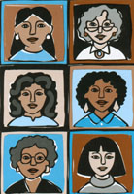
Cervical Cancer Screening
Analysis of Disproportionate Under-Representation
Data contained within the analysis represent 47,387 women between 24 -64 years of age
who are members of ACLA.
Included data corresponding to:
LDH Region of Residence
Age
Race
Language
Flagged event associated with CCS
Notes:
Acquired data 47387 AmeriHealth Caritas female members between age 24-64. Conducted an analysis of disproportionate populations analysis to determine which member subgroups were most significantly affected by specific disparities.
Equation: 23530(Enrollees that received an appropriate CCS screen)/47387 (24-64 yo F members)
Although the measure definition encompasses ages 21 to 64, the actual calculation covers patients ages 24 to 64 to allow for women to be screened within three years of turning 21 and before reaching age 64.

Slide 9
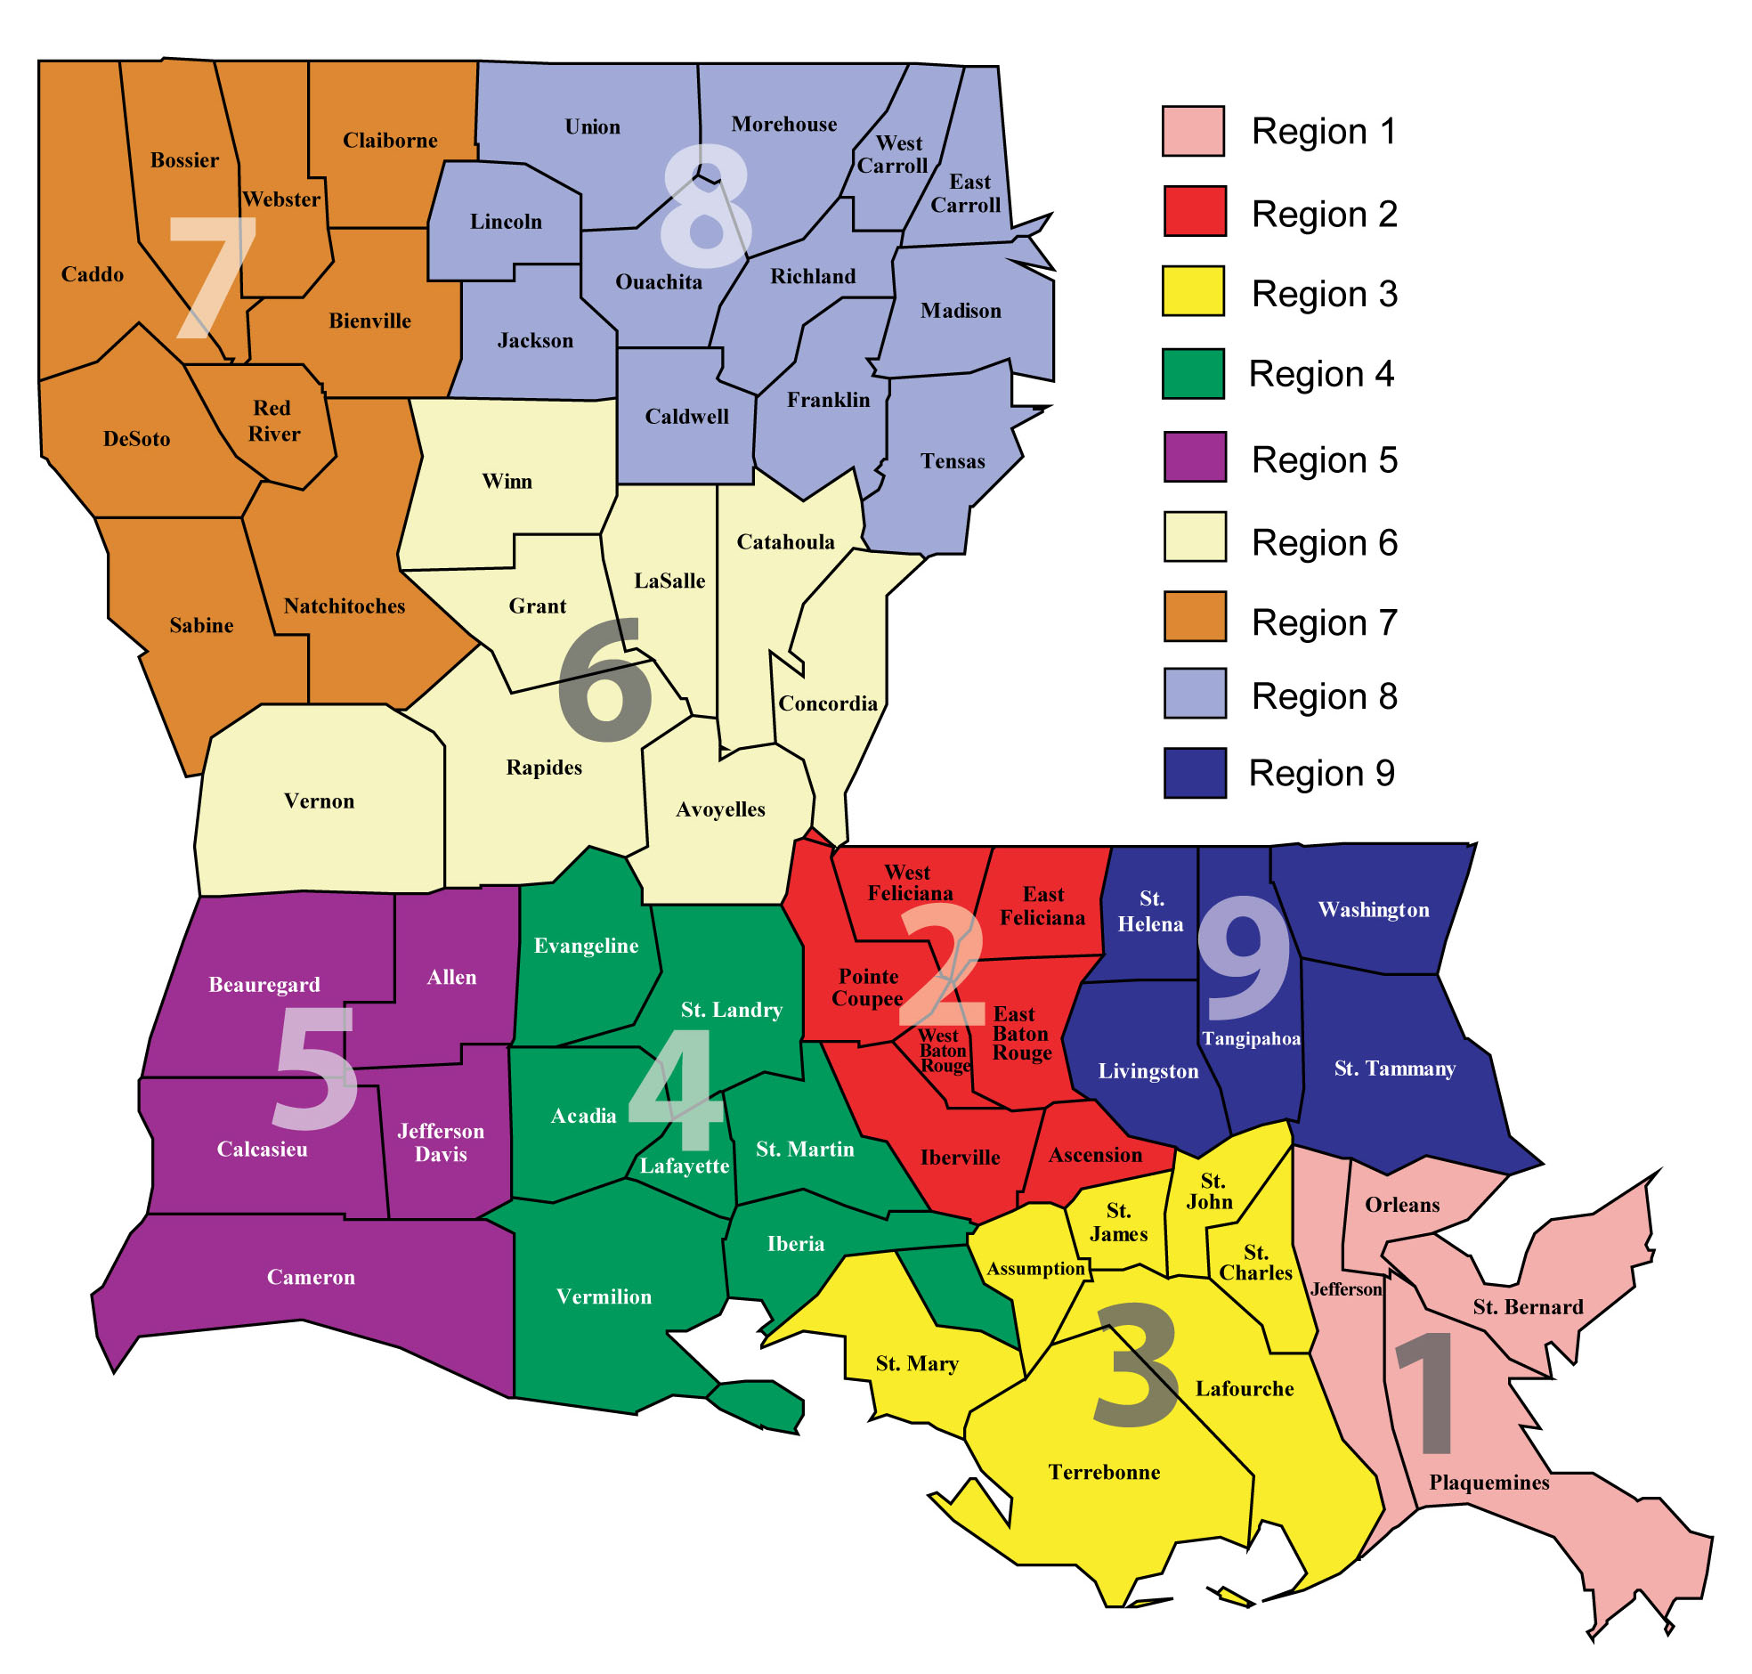


CCS Disproportionate Index Analysis:
Region of Residence
Region | Disproportionate Index | Number of Healthcare Providers Trained in CCS **
Region 1 | 91.37 % | 1868
Region 2 | 97.85 % | 1326
Region 3 | 95.38 % | 481
Region 4 | 99.09 % | 997
Region 5 | 112.86 % | 441
Region 6 | 104.95 % | 524
Region 7 | 103.80 % | 993
Region 8 | 107.80 % | 675
Region 9 | 99.09 % | 859
Unknown | 100.44 % | 174
Notes:
Region with highest compliance of CCS: Region 1
Region with lowest compliance of CCS: Region 5
Corresponds with lowest number of healthcare providers trained to perform CCS
Trained to perform CCS does not capture knowledge, physician comfort with performing CCS, screening volume, or the providers’ ability to deliver safe, high-quality reproductive health services.
Provider subspecialities included: Advanced NP, CNM, family medicine, Family NP, General practice, gynecology, internal medicine, NP (other), Obstetrics and gynecology, obstetrics, Pas, Preventative medicine
Region 3 has a very similar number of providers to region 5 (lowest performing region), but its disproportionate index does not represent a disparity
Further subpopulation analysis is needed to look for other disparities embedded within these populations: providers who actual perform pap smears vs trained, education, age

Slide 10

Demographic Characteristics of Appropriately Screened and Total Eligible ACLA Members for Cervical Cancer
Demographic Characteristic | Proportion of Members |  | Appropriate CCS Obtained |  | Disproportionate Index | Disparity
 | Count | % | Count | %
Age
24 years – 30 years | 11639 | 24.56 % | 6329 | 26.90 % | 91.32 %
31 + years | 35748 | 75.44 % | 17201 | 73.10 % | 103.20 %
Race
American Indian/ Alaska Native | 303 | 0.64 % | 143 | 0.61 % | 105.21 % | 4th
Asian | 422 | 0.89 % | 185 | 0.79 % | 113.27 % | 2nd
Black/African American | 23191 | 48.94 % | 12710 | 54.02 % | 90.60 %
Asian Indian | 264 | 0.56 % | 143 | 0.61 % | 91. 67 %
White | 17855 | 37.68 % | 8163 | 34.69 % | 108.61 % | 3rd
Other | 1 | 0 % | 1 | 0 % | 49.65 %
Unknown | 5351 | 11.29 % | 2185 | 9.29 % | 121.60 % | 1st
MCO Total | 47387 |  | 23530 | 49.66 %

Slide 11
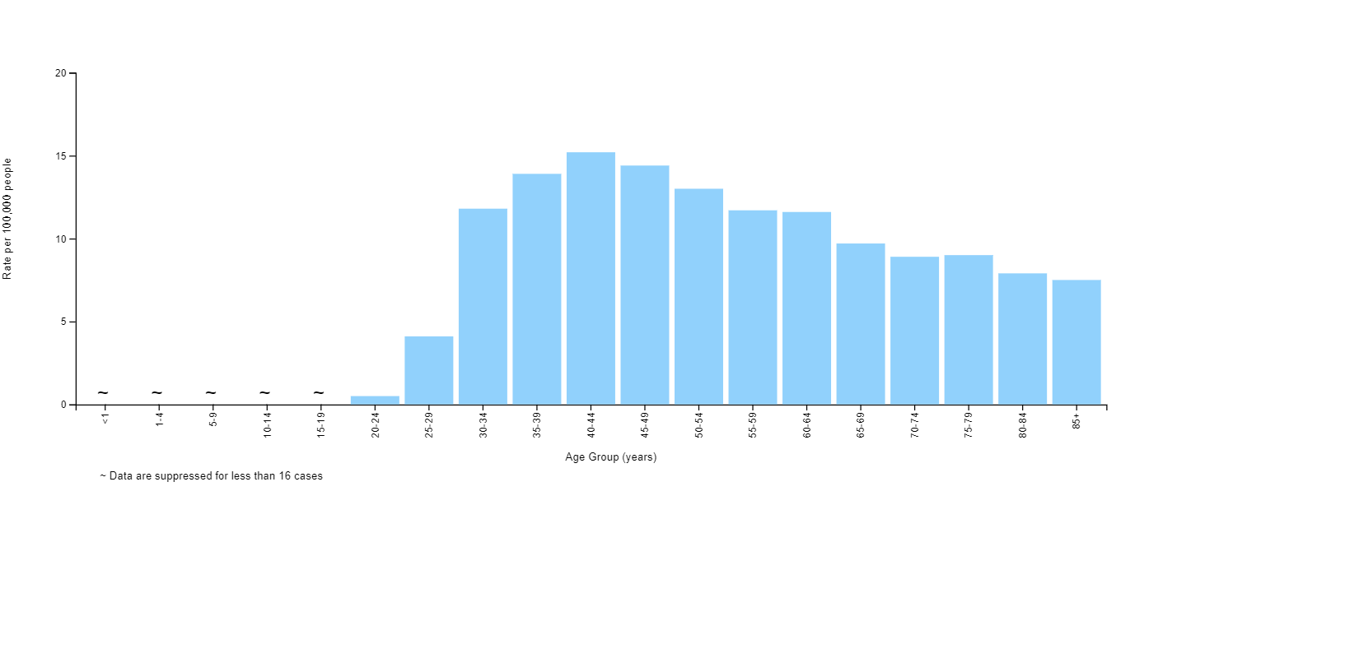
Data Recap
Region
  Highest rate of member CCS compliance: Region 1
  Lowest rate of member CCS compliance: Region 5
    Corresponds to the region with the lowest number of healthcare workers trained to perform CCS
Age
Racial Disparities
  Racial groups with the most significant disparities in CCS
    1)Asian 2) White 3)American Indian/ Alaska Native
  Highest rate of CCS compliance by race: Black/African Americans
Language
  No statistically significant disparity was identified in the data set
Flagged Events
  Laboratory reports >>> EMR
Women ≥ 30 years of age:
↑ incidence
↓ spontaneous HPV clearance rates

Slide 12
Recommendations
Optimize Current ACLA Interventions
Expand Current Scope
Increased Technology Integration
  Expand community partnerships into regions with high disproportionate indices
    Community events
    Mobile units
    FQHCs
  Education
    Provider
      Peer-to-peer education
      Portal training
      Documentation
    Members
      Provider- and MCO-driven education
    More widespread distribution of educational materials
  Flag members within the ACLA system overdue for CCS
    Provider reports
    MCO-led outreach to flagged members
  Targeted campaigns
    HPV vaccination
      Dental Health Provider Partnerships
  Data collection and analysis
    Barriers to screening
    Health literacy assessments
    Provider and member surveys
  Address Needs of Special Populations
    Recently incarcerated
    Individuals experiencing housing instability
    Racial, cultural, and ethnic groups
  Barrier specific interventions
    Extended office hours or Saturday appointments
    Free rides
  Community Health Workers
  Screening reminders
    Provider and MCO
      Automated calls, Messages, e-mail communication
    Maintain up-to-date contact information for members
    Higher volume of social media engagement
  Electronic Medical Record
    Quality measures pop-ups

Slide 13


Acknowledgments
LaKaley Tillery
Dr. Gregory Randolph
Dana Smith
Carrie Blades
Jana Blaylock
Rhonda Baird
Thank you!
Questions?

Slide 14
References
U.S. Cancer Statistics Working Group. U.S. Cancer Statistics Data Visualizations Tool, based on November 2019 submission data (1999-2015): U.S. Department of Health and Human Services, Centers for Disease Control and Prevention and National Cancer Institute; November 2022.[Available from: www.cdc.ov/cancer/DataViz ]
“Black Corals: A Gem of Cancer Screening Program in South Carolina.” The Community Guide, 18 Oct. 2022, https://www.thecommunityguide.org/stories/black-corals-gem-cancer-screening-program-south-carolina.html.
“Cervical Cancer.” World Health Organization, World Health Organization, https://www.who.int/news-room/fact-sheets/detail/cervical-cancer.
Institute of Medicine (US) and National Research Council (US) National Cancer Policy Board; Curry SJ, Byers T, Hewitt M, editors. Fulfilling the Potential of Cancer Prevention and Early Detection. Washington (DC): National Academies Press (US); 2003. 6, Improving Participation in Cancer Screening Programs. Available from: https://www.ncbi.nlm.nih.gov/books/NBK223927/

Slide 15
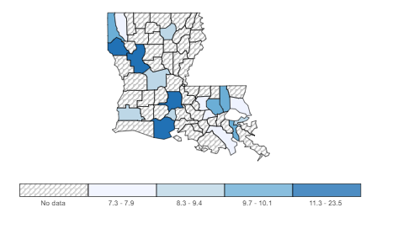
Rate of New Cancers in Louisiana
Cervix, All Ages, All Races and Ethnicities, Female, 2015-2019
Source - U.S. Cancer Statistics Working Group. U.S. Cancer Statistics Data Visualizations Tool, based on 2021 submission data (1999-2019): U.S. Department of Health and Human Services, Centers for Disease Control and Prevention and National Cancer Institute; https://www.cdc.gov/cancer/dataviz, released in November 2022.

Slide 16
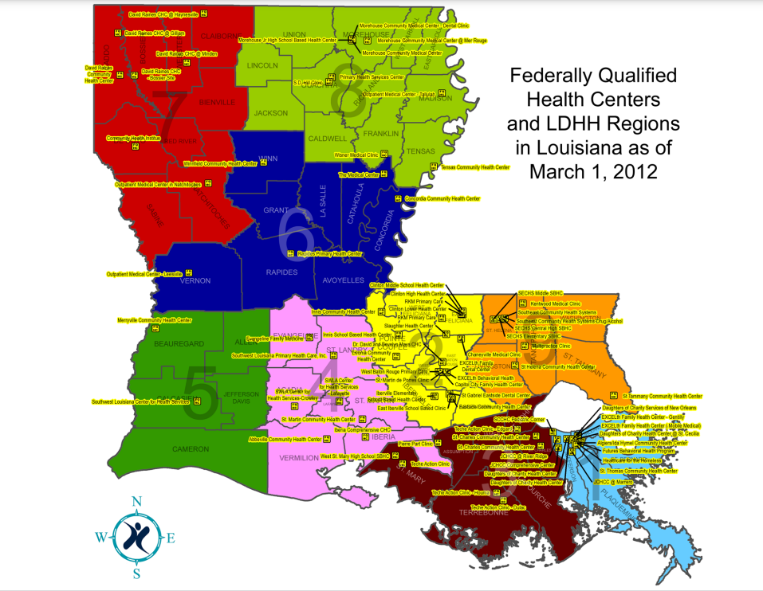

Slide 17
