Slide 1

Population Health Project
March 2023
Lauren Jackson
Louisiana State University Health Sciences Center New Orleans
School of Medicine, Class of 2023
AmeriHealth Caritas Louisiana Medical Intern

Slide 2
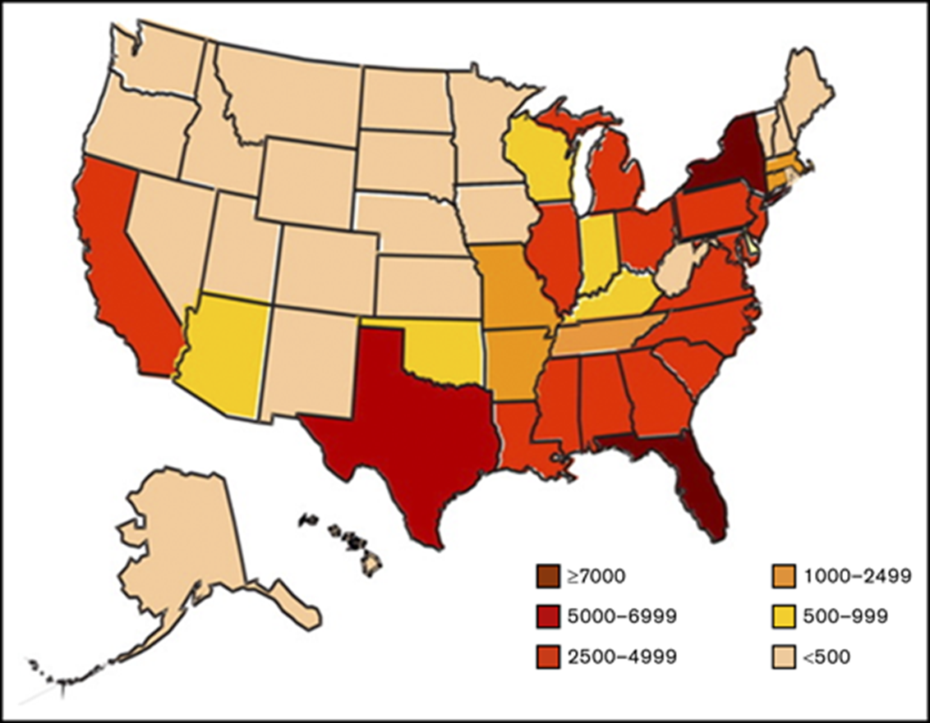
Background
-Sickle Cell Disease (SCD) is a genetic disorder that affects about 100,000 people in the United States
-Approximately 90% of persons with SCD in the United States are Black or African American (Black). Hispanic or Latino (Hispanic) persons also make up a large portion
Sickle Cell patients in Louisiana
-Each year, approximately 80 infants are born with SCD in Louisiana with
-Approximately 3000 children and adults living with SCD in the state.
Estimated number of individuals with SCD, based on state-specific African American and Hispanic birth-cohort disease prevalence and 2008 US census population, corrected for early mortality. Reprinted from Hassell⁴⁹ with permission from Elsevier.
Notes:
.

Slide 3
According to 2022 data ACLA has 411 members with Sickle Cell Disease
ACLA paid a total of $7,091,340.37 in claims for members with Sickle Cell disease
Total ED visits 4,446
Average 29 ED visits per member last year
ACLA spent a total of $875,621.57 in Emergency Department bills for members with SCD in 2022

Slide 4
Purpose Statement
One of the main stays in quality management of Sickle Cell patients is usage of specialty care with hematologist/oncologist
With this project I wish to examine disparities in the utilization of specialty care with hematologist/oncologist in Louisiana

Slide 5
Utilization of specialty care in Louisiana by ACLA members
61 (15%) ACLA members were seen by adult specialist
130 (32%) ACLA members saw a pediatric specialist
220 (53%) ACLA members saw no specialist last year

Slide 6
Increased use of Pediatric specialist?
The transition from pediatric to adult care in patients with SCD presents a challenge. Within adult hematology, SCD has been under addressed
One-quarter of patients with SCD from 18-25 develop increasing complications of disease, leading to higher health-care resource utilization, and this progression doesn’t necessarily plateau with age. These findings highlight the need for research foci and improved clinical care targeted to these growing patient subgroups.

Slide 7
Two pathways
Improve education of Primary care providers and Acute care providers
Increase utilization of specialty care

Slide 8
Increase Provider awareness of current education materials, guidelines, and resources
ASH Clinical Practice Guidelines on Sickle Cell Disease. (New as of 2020-2021)
Cardiopulmonary and Kidney Disease
Transfusion Support
Cerebrovascular Disease
Management of Acute and Chronic Pain
Stem Cell Transplantation
ACEP ASH SCD PAIN POINT-OF-CARE TOOL (2021)
ASH and ACEP partnered to develop tools for Emergency Department physicians based on ASH SCD guidelines.
Notes:
2020-2021

Slide 9
Implement Project ECHO
Project ECHO® (Extension for Community Healthcare Outcomes) is a model of telementoring and training. The program’s objective is to connect providers with SCD experts so that they can increase their knowledge about best practices in managing individuals with this complex disease.
A new SCD series for primary care providers. This series, taught by hematologists using a case study-based, tele-mentoring approach, will cover basics of SCD care, such as pain management, hydro
Participating primary care providers will also be eligible to request on-demand consultative services from hematologists to further support SCD care and mentoring

Slide 10
Widespread implementation of SCD toolkit, and readiness resources to patients, and providers
Patients should have early discussion of transition
There should be collaboration among patients, families, and providers to create the transition plan
Annual transition readiness assessments
Communication between pediatric and adult providers during transfer of care.
Transition toolkit for SCD that provides disease-specific instruments that can be used during the transition process
Can be found on American Society of Hematology website

Slide 11
Sickle Cell centers in Louisiana
Region | Clinic Address | Medical Staff
Regions 1, 3, 9 Assumption, Jefferson, Lafourche,Livingston, St. Charles, Orleans, Plaquemines, St. Bernard, St. James, St. John, St Helena, St. Mary, Terrebonne, St. Tammany, Tangipahoa, Washington | Sickle Cell Center of Southern Louisiana Adult & Transitional Clinic-Tulane University 50 South Liberty Street (Adult & Transitional Clinic) New Orleans, LA 70112 (504) 988-5413 | Cindy Leissinger, MD Amy Kinzie, DNP, APRN, FNP-C
 | Children's Hospital New Orleans 200 Henry Clay Avenue New Orleans, LA 70118 (504) 896-9740 | Renee Gardner, MD Dana LeBlanc, MD Maria Velez, MD Pinky Prasad, MD
 | Ochsner Foundation Hospital 1315 Jefferson Highway New Orleans, LA 70121 (504) 842-5031 | Raj Warrier, MD Craig Lotterman, MD Matthew Fletcher, MD Robert Vasquez, MD
 | Tulane Lakeside Hospital for Women and Children 4th Floor (Pediatric Clinic) 4700 S. Interstate 10 Service Road West Metairie, LA 70001 (504) 988-6253 | Amina Rafique, MD (Pediatric & Transition Age) Corey Falcon, MD (Pediatric & Transition Age)
Region 2 Ascension, E. Baton Rouge, E. Feliciana, Iberville, Pointe Coupee, W. Baton Rouge, W. Feliciana | St. Jude Children's HospitalBaton Rouge Affiliate Clinic (Pediatric Clinic) 8300 Constantine Boulevard Baton Rouge, LA 70809 (225) 374-1485 | Sheila Moore, MD Jeffrey Deyo, MD Kacie Sims, MD Lauren Raney, MD Jessica Templet, PA-C Katherine Helo, CPNP J. Mason Kent, PA-C
 | Our Lady of the Lake Adult Sickle Cell Clinic LSU Health Baton Rouge North Clinic 5349 Airline Highway Baton Rouge, LA 70805 (225) 358-2370 | Siva Yadlapati, MD Bridgette Pierre, NP Tanisha Smith, NP
Region 4 Acadia, Evangeline, Iberia, Lafayette, St. Landry, St. Martin, Vermillion | Our Lady of Lourdes Kids Specialty Center 4704 Ambassador Caffery Parkway Lafayette, LA 70508 (337) 470-5565 | Jeffrey Deyo, MDKacie Sims, MD Lauren Raney, MD Katherine Helo, CPNP J. Mason Kent, PA-C
Region 5 Allen, Beauregard, Calcasieu, Cameron, Jefferson Davis | Moss Memorial Health Clinic Sickle Cell Clinic 1000 Walters Street Lake Charles, LA 70607 (337) 480-8066 | Renee Gardner, MD
Region 6 Avoyelles, Catahoula, Concordia, Grant, LaSalle, Rapides, Vernon, Winn | Alexandria Sickle Cell Clinic Rapides Parish Health Unit 5604-A Coliseum Boulevard Alexandria, LA 71303 (318) 487-5282 | Majed Jeroudi, MD
Region 7 Bienville, Bossier, Caddo, Claiborne, DeSoto, Natchitoches, Red River, Sabine, Webster | Sickle Cell Center of Northern Louisiana LSUHSC Shreveport Feist-Weiller Cancer Center St. Jude Affiliate Clinic 1405 Kings Highway Shreveport, LA 71104 (318) 813-1000 | Dr. Richard Mansour (Director, Adult Clinic) Dr. Samip Master (Adult Clinic) Dr. Poornima Ramadas (Adult Clinic) Dr. Glenn Mills (Adult Clinic) Dr. Majed Jeroudi (Director, Pediatric Clinic) Robert Duncan, PA Tabitha Jones, FNP
Region 8 Caldwell, E. Carroll, Franklin, Jackson, Lincoln, Madison, Morehouse, Ouachita, Richland, Tensas, Union, W. Carroll | Monroe Sickle Cell Center Ouachita Parish Health Unit 1650 Desiard Street Monroe, LA 71201 (318) 361-7282

Slide 12
Recommendations
Advertise project Echo to primary care providers in online newsletters
Share current guidelines and provider resources
Increase awareness of Sickle Cell disease via social media
Promote use of Sickle cell centers specifically targeting region 7, 1, and 2.
Increase ACLA data retrieval for SCD members
-Would like to know how many pediatric and adult members

Slide 13
Works Cited
https://ashpublications.org/hematology/article/2019/1/496/422635/A-program-of-transition-to-adult-care-for-sickle
https://www.nichq.org/project/sickle-cell-disease-treatment-demonstration-regional-collaboratives-program-nationalxyurea, and preventive services.
https://www.hematology.org/-/media/hematology/files/education/clinicians/guidelines-quality/documents/ash_scd-guideline-methodology-infographic_2019.pdf?la=en&hash=EDF12B69038579686DA2FAB3095590A5
https://ashpublications.org/bloodadvances/article/4/16/3804/461777/Building-access-to-care-in-adult-sickle-cell?utm_source=TrendMD&utm_medium=cpc&utm_campaign=Blood_Advances_TrendMD_0
https://ashpublications.org/blood/article/132/Supplement%201/2226/261707/Interruption-in-Care-Continuity-during-Healthcare?utm_source=TrendMD&utm_medium=cpc&utm_campaign=Blood_TrendMD_0
https://ashpublications.org/blood/article/132/Supplement%201/2226/261707/Interruption-in-Care-Continuity-during-Healthcare?utm_source=TrendMD&utm_medium=cpc&utm_campaign=Blood_TrendMD_0

Slide 14
Works Cited
https://www.cdc.gov/mmwr/volumes/71/ss/ss7109a1.htm
https://www.ajmc.com/view/patients-with-sickle-cell-disease-less-likely-to-receive-specialized-care

