Slide 1
Overview of ACLA Behavioral Health Focus Measures
Catherine Fontenot
LSUHSC New Orleans - Population Health Management Course
November 18, 2022

Slide 2
Outline
Behavioral Health Focus Measures Overview
Louisiana Information
ACLA Statistics
More to Explore

Slide 3
FUM – Follow-Up After ED Visit
Patients 6+ years old – Dx of mental illness or self-harm
Follow-up with any provider
% of discharges for which patient had follow-up within 30 days
% of discharges for which patient had follow-up in 7 days
  Within 3 days more likely engage in care
  Longer time period before return to ED
Notes:
Now that we know what we’re looking for, let’s look at Louisiana…

Slide 4
FUH – Follow-Up After Hospitalization
Patients 6+ years old – Dx of mental illness or self-harm
Follow-up with mental health provider
% of discharges for which patient had follow-up within 30 days
  Lower risk of 90-day readmission
% of discharges for which patient had follow-up in 7 days
  Decreased risk of death by suicide
Notes:
Just to start with some definitions of what we are looking at, there are 2 measures
***Process measures
Mandated by CMS and NQF

Slide 5
Louisiana
Population: 4.65 million
Poverty rate: 19.6%, >930,000
Adult Medicaid Enrollment: 732,000 (thx, JBE)
HRSA Mental Health HPSA
  Affected population >3.6 million
  26.15% of needs met
  166 practitioners needed, increase from 2021
Notes:
CENSUS.GOV
HRSA.GOV 2022 HPSA QUARTERLY REPORT
I rounded here – I realize that these number include 10s of thousands more patients, which is not negligible
a doctor of medicine or osteopathy, clinical psychologist, nurse practitioner, or a clinical social worker
psychiatrists, psychologists, psychiatric nurses, addiction counselors, and mental health or family and marriage counselors.
PRIMARY CARE HPSA
>2.5million people, 64.4% of needs being met, need 298 more primary care providers
Up from 151 practitioners needed in 2021

Slide 6
Mental Health Patient Panel – 2500 Patients
Provider Type | FTE
Licensed Mental Health Provider* | 0.9
Psychiatrist** | 0.1
Other Mental Health Staff | 0.4
Substance Abuse Provider | 0.3
*Per HRSA HPSA, LA needs 166 more mental health practitioners
**Per KFF, LA has 652 active practicing psychiatrists
Notes:
Number of patients regularly under the care of FTE physician
Language here – clarify provider vs practitioner
2010 published 2013: The model suggested the need for approximately 0.9 licensed mental health provider FTE, 0.1 FTE psychiatrist, 0.4 FTE other mental health staff, and 0.3 FTE substance abuse provider per 2,500 medical patients.
0.1 psychiatrist – because WHO NEEDS THOSE
652 active practicing psychiatrists as of sept 2022 in LA (KFF) – didn’t split adult vs pediatric
Number of patients regularly under the care of FTE physician
2010 published 2013: The model suggested the need for approximately 0.9 licensed mental health provider FTE, 0.1 FTE psychiatrist, 0.4 FTE other mental health staff, and 0.3 FTE substance abuse provider per 2,500 medical patients.
652 active practicing psychiatrists as of sept 2022 in LA (KFF)

Slide 7
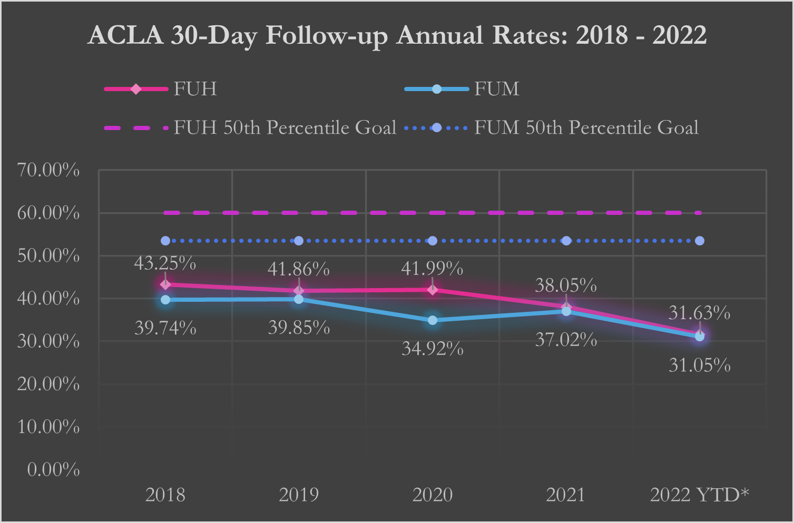
Covid
Covid
“Post-Covid”
Hurricane Laura
Hurricane Ida
Notes:
FUH is mental health provider after hospitalization
FUM is any provider after ED visit
Goals of the national 50th percentile are marked on respective lines – 60% and 53.5%
Remember with the HPSA that only ~25% of LA’s total mental health practitioner needs are met
Goal is 2% improvement per year given distance from 50th percentile
2022 YTD, FUM is close to 2021, FUH is ~2% lower

Slide 8
FUH by Parish YTD
 | Discharges | Patients | Compliance Rate | MH Providers
EBR | 304 | 246 | 29.28% | 238
Orleans | 275 | 211 | 21.09% | 225
Caddo | 235 | 192 | 36.60% | 92
Jefferson | 230 | 197 | 29.57% | 198
Calcasieu | 199 | 157 | 20.10% | 58
Lafayette | 188 | 139 | 33.51% | 78

Slide 9
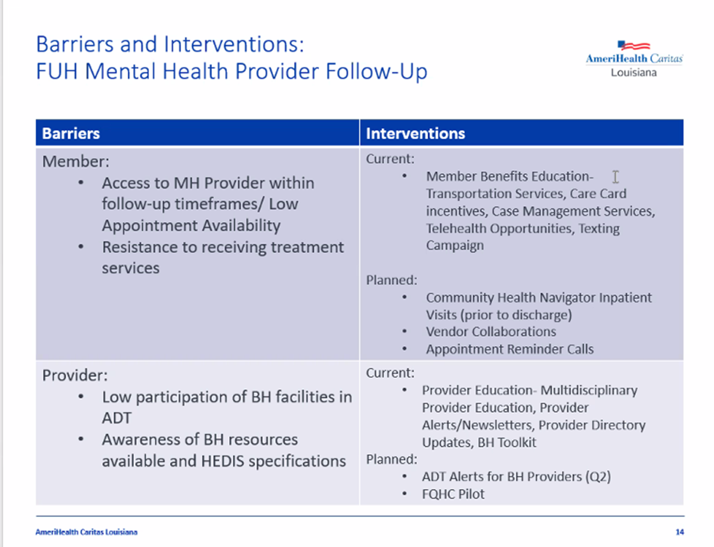

Slide 10


More to Explore
Survey
Survey patients for reasons they do not follow-up
Appointments scheduled and missed, or not scheduled?
Transportation, knowledge, reminders
Walk
Walk patients to clinic location before discharge
Clinic location at same hospital
Which staff would do this? How would ACLA track?
Explore
Explore extent and potential for telehealth access
Health plan coverage and providers
Smart phones with data and apps, computers with Internet
Evaluate
Further evaluate Covid lags, post-Hurricanes Laura & Ida population shifts, access changes
Diagnosis code for admission

Slide 11
End

Slide 12
Citations
file:///C:/Users/cfon14/Downloads/BCD_HPSA_SCR50_Qtr_Smry.pdf
https://www.ncbi.nlm.nih.gov/pmc/articles/PMC3359082/
https://www.ncbi.nlm.nih.gov/pmc/articles/PMC3750356/#:~:text=The%20model%20suggested%20the%20need,provider%20per%202%2C500%20medical%20patients
https://www.kff.org/statedata/mental-health-and-substance-use-state-fact-sheets/louisiana/
NQF Measures 0576 and 3489
https://www.ncqa.org/wp-content/uploads/2021/07/20210701_Behavioral_Health_Quality_Framework_NCQA_White_Paper.pdf
ACLA Data

