Slide 1

Childhood immunizations
Sarajane Gross
LSU 4th year Medical Student
AmeriHealth Caritas Intern

Slide 2
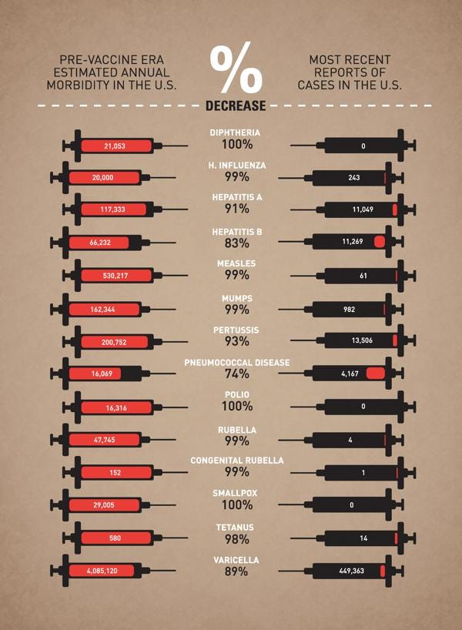
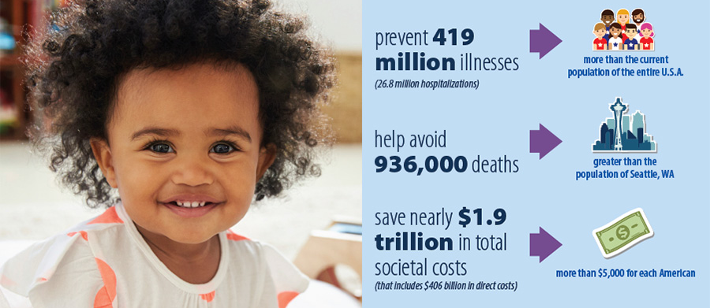
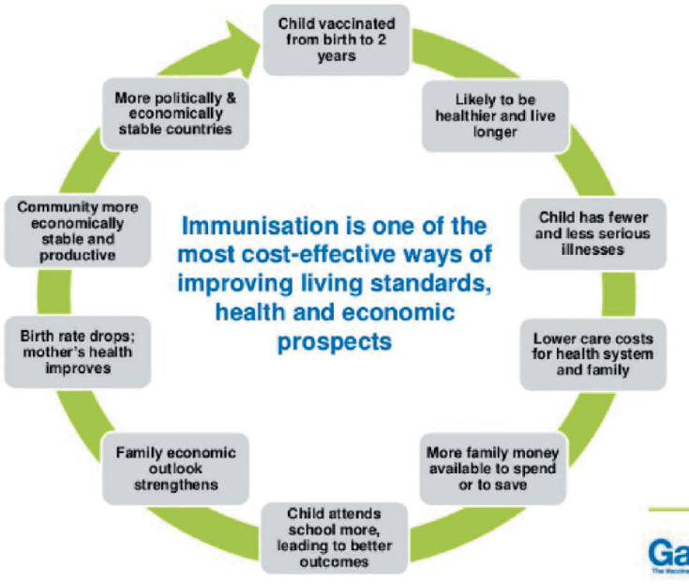
Notes:
Impact and utility of vaccines
Major public health and preventative health care management implications
How it’s transformed the prevalence of major diseases in US

Slide 3

Cis combo 3
Includes all enrollees turning 2 by 12/31/2022
DtAP x4, IPV x3, MMR x1, Hib x3, Hep B x3, VZV x1, PCV x4
Program Goals:
Increase rates while reinforcing importance of vaccines in disease prevention
Increase provision of/timeliness of Early Periodic Screening Diagnosis and Treatment/Services (EPSDT)
Decrease avoidable hospitalizations
Notes:
Managed care organization – want to decrease hospitalizations

Slide 4
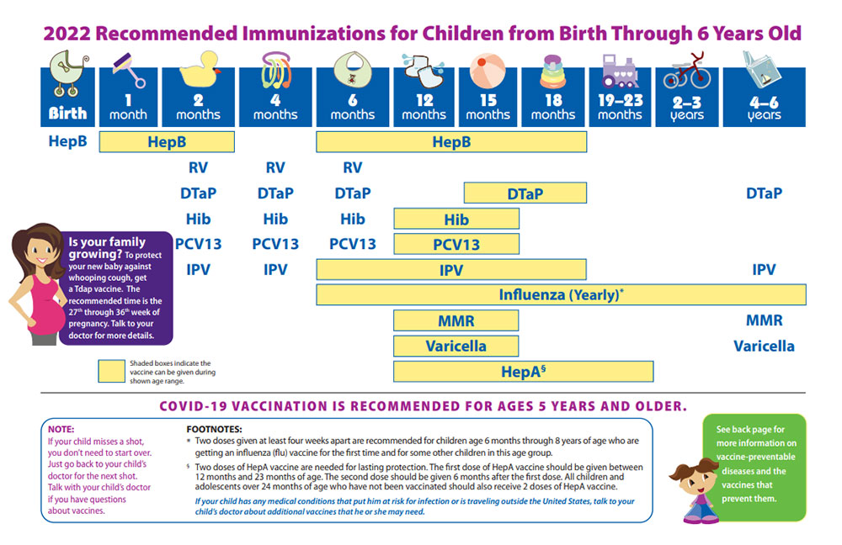
Cdc schedule
Notes:
Possible completion by 18 months; measure gives room for catch up

Slide 5
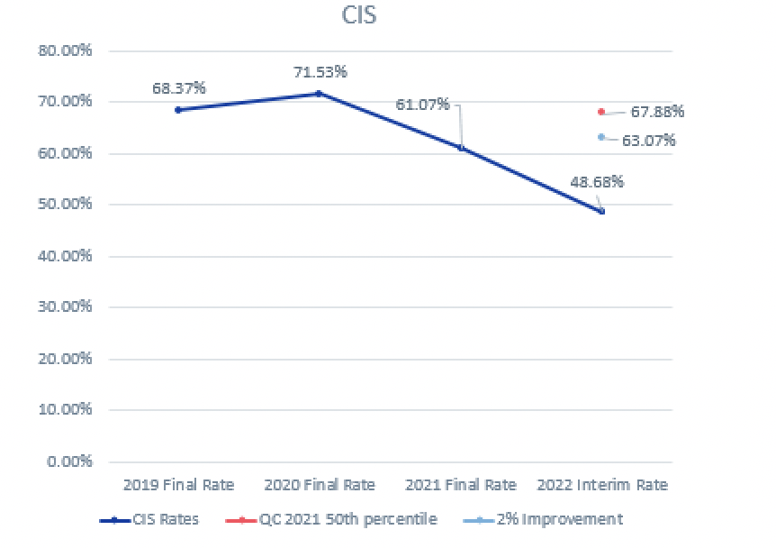
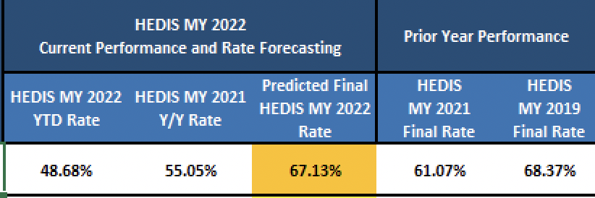
Annual goals/ rates
Or 63.07%
Notes:
Data as of 9/12/22
GOAL for 2% increase 63.07%
In order to meet or be eligible for the incentive
Pictorial of where we were in 2020 which was pandemic onset and the effects we’ve seen and experienced from that

Slide 6
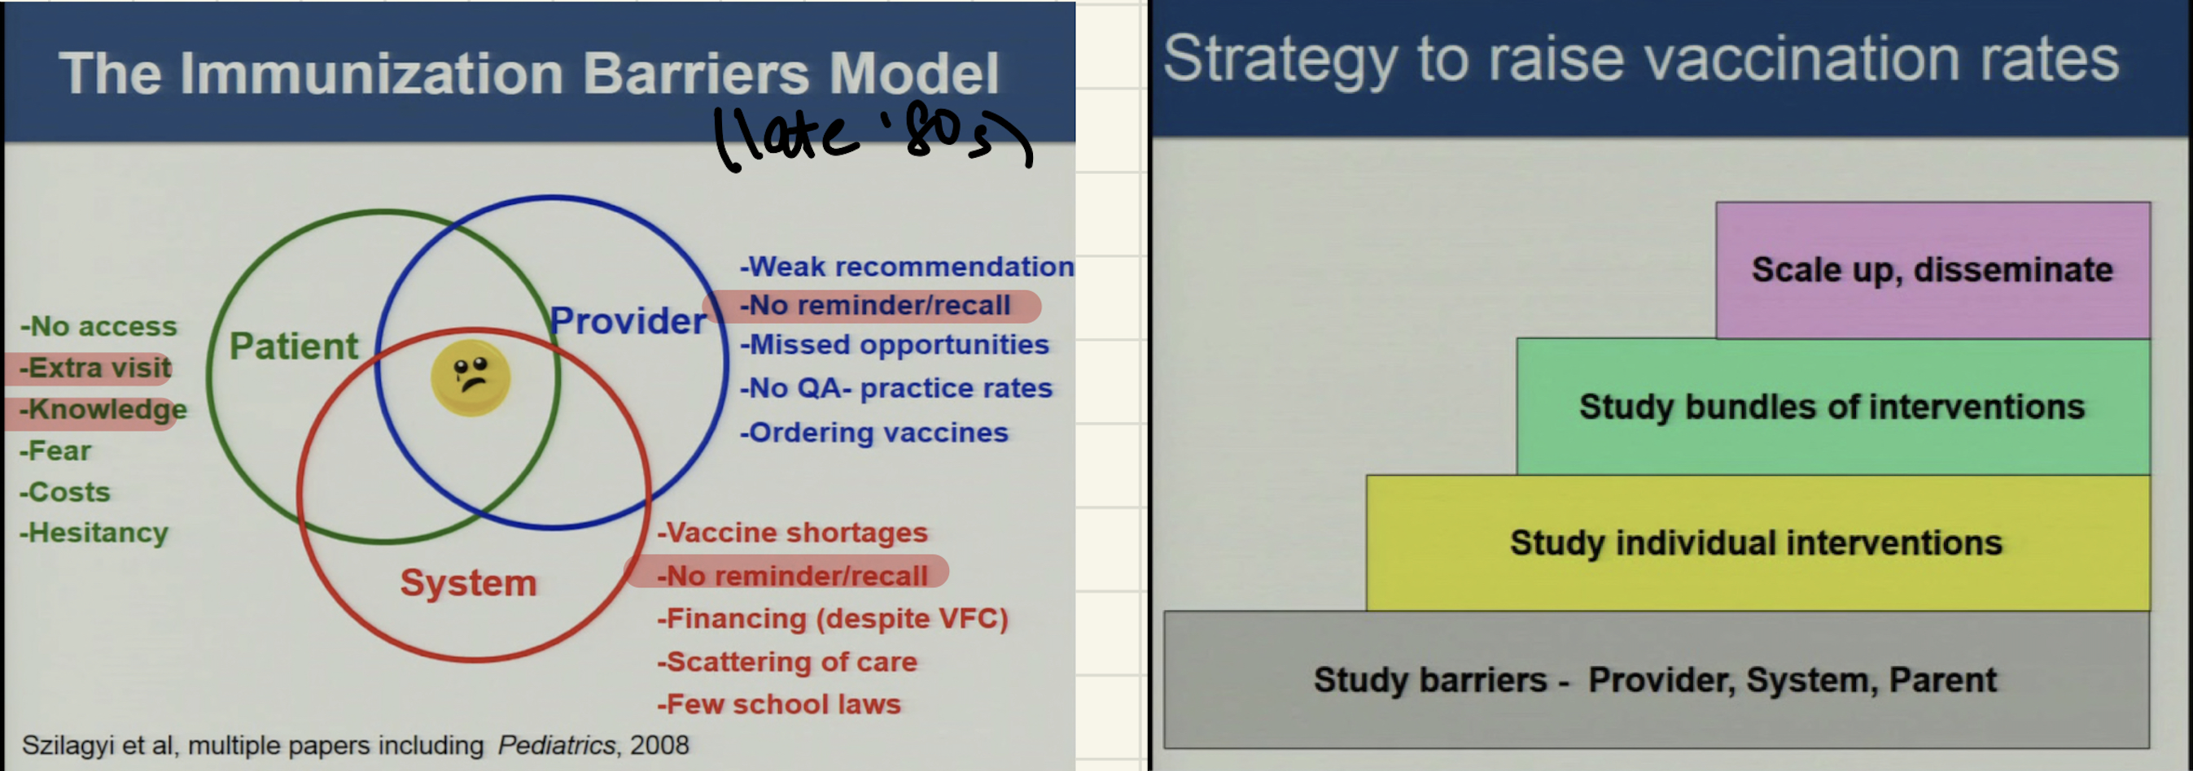
Dr. Peter Szilagyi, Grand Rounds at ucla mattel children’s Hospital (2016)
Notes:
He studied childhood immunization rates
Szilagyi developed this model of the immunization barriers from each perspective of patient, provider, and system. Real issue at the provider and system level.
Strategy to raise vaccine rates is to first study these barriers → then study individual interventions → then bundles → then scale up.
3 largest barriers are those highlighted. Addressing an intervention towards these will have the largest impact.
Largest impact if baseline is rate – low, can increase by 2-10% points; low impact with low income population because they’re harder to reach
Combine this with outreach
Largest impact = PT REMINDER RECALL
modality: letters, postcards, calls/texts, emails;
intensity: frequency can vary, combine with outreach
Recipient: parents/adolescents (if applicable)
Source: PCP, HMP, registry
Requirements: registry, pt contact info that is active, algorithms of who needs the vaccines, resources (workers)
Provider education on WHEN to send out recall reminders
Provider recall > insurance company
Providing members with 1 number so that they can recognize outreach texts/calls

Slide 7
Current ACLA Interventions & Barriers
Interventions
Barriers
Member and provider education
Outreach via texting campaigns and/or social media
Member and provider incentives
Newsletters/educational flyers
LA-Links data cleanup
RROT Wellness Outreach**
Lack of knowledge by parents
Vaccine myths
Lack of access to PCP
Sick visit predominance
Nonspecific vaccine claims input by providers
LA-LINKS data discrepancies
Not providing vaccines at certain sick visits

Slide 8
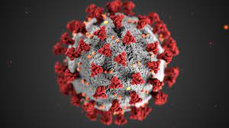
Covid-19 pandemic
Newest and largest barrier to CIS Combo 3 Measure
Parental hesitation to attend well child visits
Social distance policies/lockdowns and closed offices
Supply chain leading to shortages
Lack of PPE knowledge and supplies disrupted visits
Political impact on vaccine administration
Notes:
It appeared that the infants were less likely to miss their vaccination than older toddlers during the COVID pandemic. ^{26 , 53} This may suggest that parents put the vaccination of their infants at priority. Besides, toddlers are more active than infants, thus at greater risk of catching VPDs. Consequently, missed vaccinations and greater exposure to diseases make older children a target population for potential future outbreaks.

Slide 9
ACLA Member vaccination status
Of all members within this cohort, 7% have not received ANY vaccine
COVID vaccine status
Only 14 members of CIS Combo 3 compliant members have also received COVID vaccine (complete series)
14 members are currently overdue for their second dose
Notes:
2017 national immunization survery child on toddlers showed that roughly 1.3% had not received ANY immunizations by 24 mo
Old data but something to think about

Slide 10
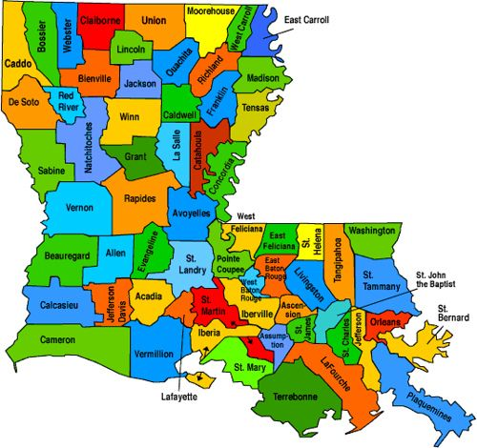
Vaccine rates per parish
Orleans: 39%
East Jefferson: 49%
Jefferson: 54%
Ascension: 54%
East Baton Rouge: 53%
St. Tammany: 36%
St. Landry: 37%
Calcasieu: 36%
Tangipahoa: 36%
Washington: 39%
Iberville: 71%
Notes:
Want to show discrepancies within neighboring areas
IBERVILLE IS RURAL – WHAT IS GOING ON HERE?

Slide 11
Clinic breakdown (pcp groups)
DePaul Community Health Center: 24%
Children’s Pediatrics Kids First Tiger Care: 37%
Sunnyside Pediatrics (Metairie, LA): 39%
Children’s International LLC: 35%
Pediatric Clinic Westbank: 48%
Pediatric Group of Acadiana: 44%
Our Lady of the Lake Physician Group: 38%
Ochsner LSU Physician Group: 45%
Notes:
*** note that some sample sizes are small (ie: small numerator and denominator)
Vaccine compliance
Depaul used to be a mental health facility, now primary care

Slide 12
Breakdown by race
Member Race | Vaccine Series NON compliant | Vaccine Series Compliant | Total number | Immunization Rates
American Indian or Alaskan Native | 4 | 5 | 9 | 56%
Asian Indian | 5 | 11 | 16 | 69%
Asian or Pacific Islander | 406 | 435 | 841 | 52%
Black or African American | 944 | 737 | 1681 | 44%
Unknown | 573 | 619 | 1192 | 52%
White | 438 | 427 | 865 | 49%
Blank | 2 | 0 | 2 | 0%
Grand Total | 2372 | 2234 | 4606
US Census Bureau: Orleans Parish 60% Black/AA
Notes:
ACLA already targeting black/AA and Hispanic population with outreach measures
***Orleans parish
Round up numbers
56, 69, 52, 44, 52, 49, 0

Slide 13
Well Child Visits and Vaccination rates
Well Child Visit (WCV) within MY 2022 | Vaccine Series NON compliant | Vaccine Series Compliant | Total | Percent of members with WCV and complete vaccine series
No WCV | 1871 | 1623 | 3494 | 46%
Yes WCV | 501 | 611 | 1112 | 55%
Total | 2372 | 2234 | 4606
46% of cohort members WITHOUT a WCV were vaccinated
55% of cohort members WITH a WCV were vaccinated
Notes:
Anecdote – I chose this project b/c I noticed in my personal experience that pts I saw in clinics were mostly up to date on vaccines.
Wanted to find out if we were missing those who are only going to urgent cares/ED visits?
46% of members WITHOUT a well child visit were vaccine compliant
**significant diff b/n members who had a wcv and were vaccinated compared to those who were not seen at wcv and vaccinated however number of vaccinated kiddos with no wcv was higher than expected. Could have included members who completed series not in this MY
**** some of these members may have not had a WCV THIS year 2022 but coud have still completed series 2021
43.73% of members in 2022 year visited the ED and also did NOT have a wellness visit
** only 3!! Members who went to ED also had their wellness checks (likely would have gone anyways)
46.96% of those without an ED visit in measure year (2022) also did not have a wellness check

Slide 14
Emergency room visits
ED Visits | Vaccine Series NON-compliant | Vaccine Series Compliant | Grand Total | Immunization Rate
ED Visit | 287 | 223 | 510
NO WCV in MY (2022) | 286 | 220 | 506 | 44%
WCV in MY (2022) | 1 | 3 | 4 | 43%
ED Visits | Vaccine Series NON-compliant | Vaccine Series Compliant | Grand Total | Immunization Rate
NO ED Visits | 2081 | 2008 | 4089
NO WCV in MY (2022) | 1581 | 1400 | 2981 | 47%
WCV in MY (2022) | 500 | 608 | 1108 | 55%
Notes:
510 members in this cohort had an ED visit in MY 2022
Of those 510, 44% of members in 2022 measure year visited the ED and also did NOT have a wellness visit and WERE vaccine compliant
** only 3!! Members who went to ED also had their wellness checks (likely would have gone anyways)
Bottom chart: 4089 members did NOT have an ED visit; 47% of those without an ED visit in measure year (2022) who also did not have a wellness check were vaccinated
44% of kids who went to ED in MY 2022 did NOT have a WCV but DID have a complete vaccine series
55% of kids who did NOT go to the ED in 2022 and DID have a WCV were vaccinated
Point here is that we found that perhaps the ED may not have played a big role in vaccination status, although we can likely conclude that having a WCV is associated with a greater likelihood of being vaccinated (expected).
May prompt us to look further into WHY members are visiting ED (ed diagnoses). They are not following up with well visit s/p ED visit.

Slide 15


summary
7% of those eligible to be included in this cohort with NO vaccines at all
Room for improvement in particular regions (eg: Orleans Parish)
No strong correlation between members who visit the ED and did not have WCV and low immunization rates
WCV associated with increased immunization rates
14 total cohort members completed full COVID vaccine series; 14 members overdue for 2nd dose
49% of members with no COVID vaccine have completed CIS Combo 3 series
Notes:
Roughly 1.3% had not received any vaccinations by 24 months, according to a report in a 2018 article on national immunization status (AAP report
LAST BULLET: While there is always room for improvement to increase member attendance to WCV in hopes that this will help to meet immunization rate for target year, data did not show a strong correlation with those members who visit ED/UC and did not go to WCV and having low vaccine rates
Maybe somewhat Association with ED visits and NO WCV

Slide 16
recommendations
Flag members within ACLA system with multiple urgent care and/or ED visits within a 6 month period
Background check – are they up to date on their immunizations or set to complete them by end of target year?
Outreach to those members who require catch up
Would require obtaining further data on urgent care visits
Continue current active interventions
Patient reminders/recall nationally proven to be most effective
Utilizing a single phone number for outreach that members/parents can save and recognize
Outreach to patients via providers; requires initial outreach to providers
Pediatric resident outreach within Orleans Parish
Obtain further information on why these clinics are showing lower rates
Audit and feedback programs
Potential for teaching opportunity with residents
Research pre-pandemic data
How much did COVID-19 pandemic affect WCV?
Opportunity for parent focus groups to discuss thoughts on vaccines
Notes:
Look at number of visits – how many kids had multiple visits to urgent care. Are they behind?? Data may show what the cut off number should be…
Resident teaching opportunity at CHNOLA with LSU – depaul and tiger care resident docs
Morning and noon report presentation?
Check with these clinics – what is missing, supplies? Patients not getting appointments? No vaccines at sick visits? Access to these appointments? Etc….
LSU recommendation – is there an audit and feedback program? Further research on why certain kids are behind?
>>> audit and feedback: assessment, feedback, incentives, and exchange method developed by Georgia state health dept and expanded by the cdc. Uses clinic level audit and feedback within an integrated quality improvement program. Used across USA and has proven effective at increasing early childhood immunization rates when implemented in public clinics/private practices. Study done that found conducting semi annual audits was associated with increased early childhood vaccination rates at the clinic level, even after controlling for other clinic characteristics. *best used in combo with other measures
MORE DATA --- need urgent care data
DID the pandemic really affect well child visits? How many kids had well child visits pre pandemic?
Parent focus group about attitudes about vaccinations? If this is plausible
Member wellness and outreach centers (NOLA and Shreveport)
***PEDIATRIC RESIDENT OUTREACH!
***LOOK FURTHER INTO SICK VISITS

Slide 17
ACLA recommendations, follow-up
Pursue resident teaching opportunities
Look further into data from sick visits
How are patients presenting at these visits?
Further education to providers on promoting vaccinations at certain sick visits
Understand further what is working well in certain parishes with higher rates (eg: Iberville, which is considered a more rural parish)
Urgent care data
ED visits data – what are the ED diagnoses at each visit

Slide 18

Thank you
LaKaley Tillery
Rhonda Baird
Dr. Rodney Wise
ACLA Quality Improvement Team
Dr. Greg Randolph
Dana Smith
LSU School of Medicine

Slide 19
References
https://www.cdc.gov/vaccines/parents/schedules/index.html
https://www.youtube.com/watch?v=vOTqqtKlp8o
https://www.ncbi.nlm.nih.gov/pmc/articles/PMC8855492/
https://www.ncbi.nlm.nih.gov/pmc/articles/PMC8933962/
https://pubmed.ncbi.nlm.nih.gov/31790027/

Slide 20

questions

