Slide 1
Louisiana Cancer Facts & Figures, Urinary Bladder Cancer
Louisiana Tumor Registry
July, 2017

Slide 2
Urinary Bladder Cancer
From 2010 to 2014, urinary bladder cancer was the 8th most common cancer in Louisiana and the 7th in U.S.¹
About 980 new urinary bladder cancer cases are expected to be diagnosed and about 220 persons are expected to die of this cancer in Louisiana in 2017.²
¹ Data source: State Cancer Profiles
² Data source: American Cancer Society, Cancer Facts & Figures 2017

Slide 3
Urinary Bladder Cancer Incidence Rates^{#,1}
Louisiana vs. US,² 2010-2014
Rate Per 100,000
9%
# Included in situ and invasive cases.
¹ Age-adjusted to the 2000 U.S. standard population.
² Incidence data source:18 SEER registries.
↓↑Rate of Louisiana is significantly different from that of the U.S.

Slide 4
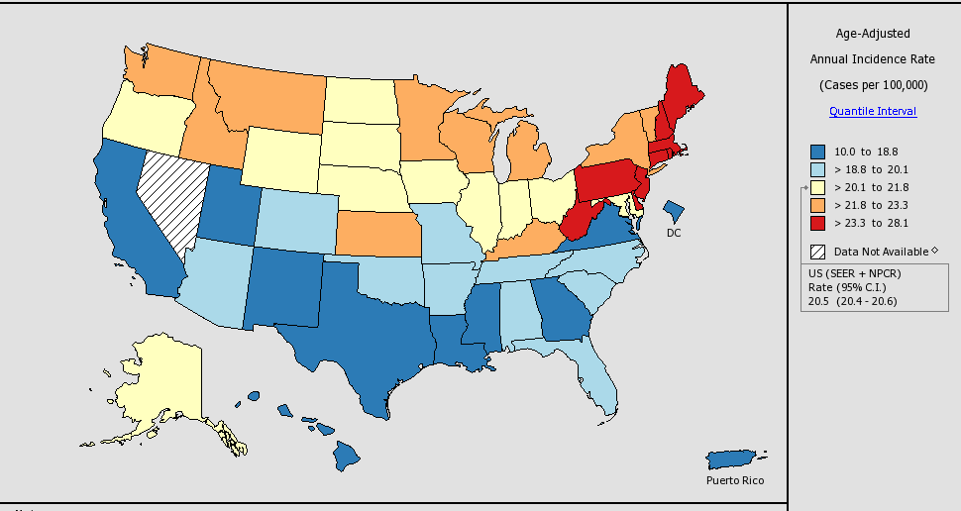
Incidence Rates# of Urinary Bladder Cancer in the U.S.,
All Races, Both Sexes, 2010-2014
# Included in situ and invasive cases.
Notes:
Louisiana:
Rate: 18.8 per 100,000
Rank: 41st

Slide 5
Urinary Bladder Cancer : Age-Specific Incidence Rates#, Louisiana, 2010-2014
# Included in situ and invasive cases.

Slide 6
Urinary Bladder Cancer : Age-Specific Incidence Rates# by Gender, 2010-2014
# Included in situ and invasive cases.
U.S. data source:18 SEER registries.

Slide 7
Urinary Bladder Cancer : Age-Specific Incidence Rates# by Race, 2010-2014
# Included in situ and invasive cases.
U.S. data source:18 SEER registries.

Slide 8
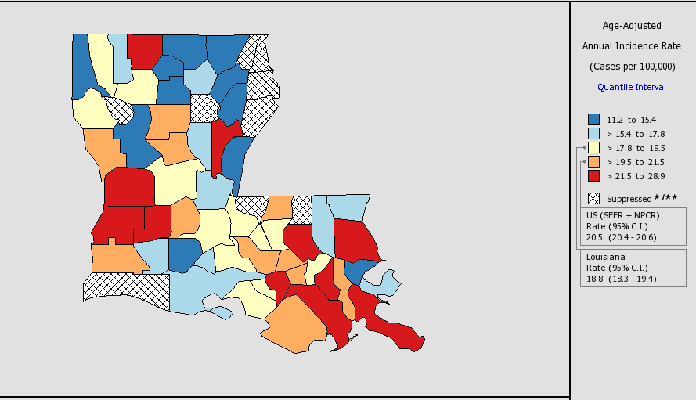
Incidence Rates # of Urinary Bladder Cancer in Louisiana, All Races, Both Sexes,
2010-2014
# Included in situ and
invasive cases.

Slide 9
Urinary Bladder Cancer Incidence Rates^{#,1,2} by Region³
Louisiana, Whites, 2010-2014
# Included in situ and invasive cases.
¹ Age-adjusted to the 2000 U.S. standard population.
² Data source for U.S. was the 18 SEER registries.
³ LTR Regions
* Incidence rate of regions/Louisiana is significantly different from that of the U.S.

Slide 10
Urinary Bladder Cancer Incidence Rates^{#,1,2} by Region³
Louisiana, Blacks, 2010-2014
# Included in situ and invasive cases.
¹ Age-adjusted to the 2000 U.S. standard population.
² Data source for U.S. was the 18 SEER registries.
³ LTR Regions
* Incidence rate of regions/Louisiana is significantly different from that of the U.S.

Slide 11
Urinary Bladder Cancer : Trends of Incidence Rates^{#,1,2} Whites, 1988-2014
# Included in situ and invasive cases.
¹ Age-adjusted to the 2000 US standard population.
² US data source: 18 SEER registries.

Slide 12
Urinary Bladder Cancer : Trends of Incidence Rates^{#,1,2}
Blacks, 1988-2014
# Included in situ and invasive cases.
¹ Age-adjusted to the 2000 US standard population.
² U.S. data source: 18 SEER registries.

Slide 13
Urinary Bladder Cancer Mortality Rates¹ Louisiana vs. US², 2010-2014
12%
24%
¹ Age-adjusted to the 2000 US standard population.
² Data source: National center of Health Statistics (NCHS).
↓↑Rate of Louisiana is significantly different from that of the U.S.

Slide 14
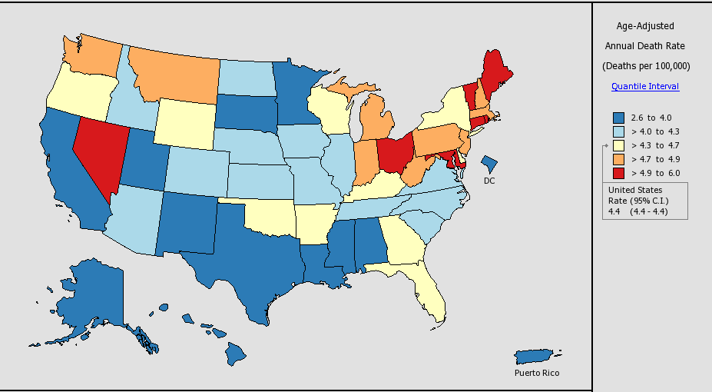
Mortality Rates of Urinary Bladder Cancer in the U.S.,
All Races, Both Sexes, 2010-2014
Notes:
Louisiana:
Rate: 4.0 per 100,000
Rank: 39th

Slide 15
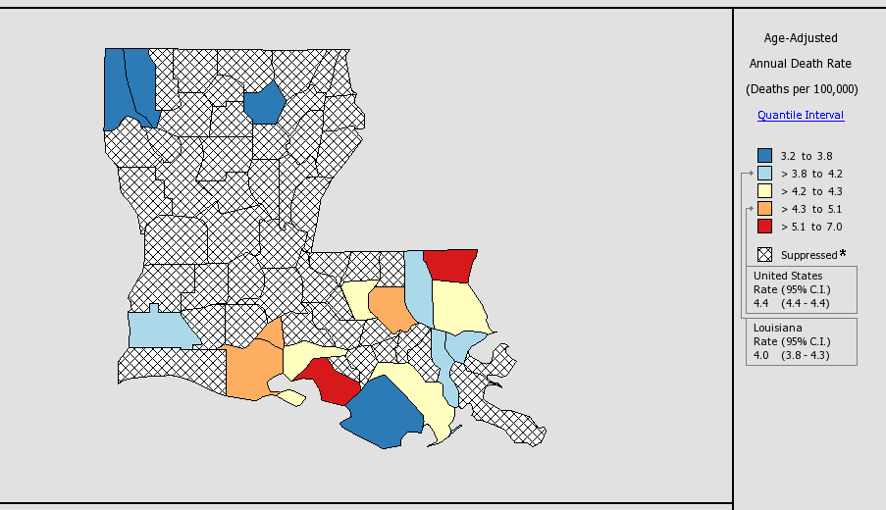
Mortality Rates of Urinary Bladder Cancer in Louisiana, All Races, Both Sexes, 2010-2014

Slide 16
Urinary Bladder Cancer : Trends of Mortality Rates^{1,2}, Whites,1988-2014
¹ Adjusted to the 2000 US standard population.
² Data source: National Center of Health Statistics (NCHS).

Slide 17
Urinary Bladder Cancer: Trends of Mortality Rates^{1,2}, Blacks,1988-2014
¹ Age-adjusted to the 2000 US standard population.
² Data source: National Center of Health Statistics (NCHS).

Slide 18
Urinary Bladder Cancer: Trends of Incidence# and Mortality Rates, by Race, Louisiana, 1988-2014
#Included in situ and invasive cases.
*Annual average percent change (APC) were calculated using weighted least squares method

Slide 19
Urinary Bladder Cancer: Trends of Incidence# and Mortality Rates, by Gender, Louisiana, 1988-2014
#Included in situ and invasive cases.
*Annual average percent change (APC) were calculated using weighted least squares method

Slide 20
Urinary Bladder Cancer# : Louisiana
5-Year Relative Survival by Stage¹, Both Sexes, All Races, 2007-2013
# Included in situ and invasive cases.
¹ The stage distribution is based on Summary Stage 2000.

Slide 21
Urinary Bladder Cancer#: Louisiana
5-Year Relative Survival by Stage¹, White Males,
All Races, 2007-2013
# Included in situ and invasive cases.
¹ The stage distribution is based on Summary Stage 2000.

Slide 22
Urinary Bladder Cancer# : Louisiana
5-Year Relative Survival by Stage¹, White Females,
All Races, 2007-2013
# Included in situ and invasive cases.
¹ The stage distribution is based on Summary Stage 2000.
* The Distant and unstaged 5-year relative survival could not be calculated due to lack of cases.

Slide 23
Urinary Bladder Cancer# : Louisiana
5-Year Relative Survival by Stage¹, Black Males,
All Races, 2007-2013
# Included in situ and invasive cases.
¹ The stage distribution is based on Summary Stage 2000.
*Unstaged 5-year relative survival could not be calculated due to lack of cases.

Slide 24
Urinary Bladder Cancer# : Louisiana
5-Year Relative Survival by Stage¹, Black Females,
All Races, 2007-2013
# Included in situ and invasive cases.
¹ The stage distribution is based on Summary Stage 2000.
* Unstaged 5-year relative survival could not be calculated due to lack of cases.

Slide 25
Appendix A. Regions of the Louisiana Tumor Registry
Regional Registry | Beginning Date of the Registry | Average Annual Population, 2010-2014 | Parishes Covered
Region 1 – New Orleans | 1974 | 21,864 | Jefferson, Orleans, St. Bernard
Region 2 – Baton Rouge | 1983 | 23,410 | Ascension, Assumption, East Baton Rouge, East Feliciana, Iberville, Livingston, Pointe Coupée, St. Helena, Tangipahoa, West Baton Rouge, West Feliciana
Region 3 – Southeast Louisiana | 1983 | 17,036 | Lafourche, Plaquemines, St. Charles, St. James, St. John, St. Tammany, Terrebonne, Washington
Region 4 – Acadiana | 1983 | 17,032 | Acadia, Evangeline, Iberia, Lafayette, St. Landry, St. Martin, St. Mary, Vermilion
Region 5 – Southwest Louisiana | 1983 | 7,698 | Allen, Beauregard, Calcasieu, Cameron, Jefferson Davis
Region 6 – Central Louisiana | 1988 | 8,283 | Avoyelles, Catahoula, Concordia, Grant, La Salle, Rapides, Vernon, Winn
Region 7 – Northwest Louisiana | 1988 | 14,817 | Bienville, Bossier, Caddo, Claiborne, De Soto, Natchitoches, Red River, Sabine, Webster
Region 8 – Northeast Louisiana | 1988 | 9,061 | Caldwell, East Carroll, Franklin, Jackson, Lincoln, Madison, Morehouse, Ouachita, Richland, Tensas, Union, West Carroll
Entire State | 1988 | 119,201
Source: U.S. Bureau of Census and National Cancer Institute, April 2017.

Slide 26
Data Sources
Surveillance, Epidemiology, and End Results (SEER) Program (www.seer.cancer.gov) SEER*Stat Databases, National Cancer Institute, DCCPS, Surveillance Research Program, Surveillance Systems Branch, released April 2017, based on the November 2016 submission.
For Incidence:
Incidence - SEER 18 Regs Research Data + Hurricane Katrina Impacted Louisiana Cases, Nov 2016 Sub (2000-2014) <Katrina/Rita Population Adjustment>
For Mortality:
mortality – All COD, Aggregated With State, Total U.S. (1969-2014) <Katrina/Rita Population Adjustment>>
For Survival:
Incidence - SEER 18 Regs Research Data + Hurricane Katrina Impacted Louisiana Cases, Nov 2015 Sub (1973-2013 varying)

Slide 27
Data Sources
USCS:
  U.S. Cancer Statistics Working Group. United States Cancer Statistics: 1999-2014 Incidence and Mortality Web-based Report. Atlanta: U.S. Department of Health and Human Services, Centers for Disease Control and Prevention and National Cancer Institute; 2017. Available at: www.cdc.gov/uscs.
Cancer Facts & Figures:
  American Cancer Society. Cancer Facts & Figures 2017. Atlanta: American Cancer Society; 2017.

Slide 28
Data Sources
NCI State profiles
Incidence Data Sources:
  Incidence data are provided by the National Program of Cancer Registries External Web Site Policy Cancer Surveillance System (NPCR-CSS), Centers for Disease Control and Prevention and by the National Cancer Institute's Surveillance, Epidemiology, and End Results (SEER) Program External Web Site Policy.
  Population counts for denominators are based on Census populations as modified by NCI.
  Rates are calculated using SEER*Stat External Web Site Policy.
Mortality Data Sources:
  Mortality data are provided by the National Vital Statistics System External Web Site Policy at the National Center for Health Statistics of the Centers for Disease Control and Prevention.
  Population counts for denominators are based on Census populations as modified by NCI..
  Rates are calculated using SEER*Stat External Web Site Policy.
  Trends are determined by using Joinpoint External Web Site Policy analysis of available historical data and reporting the last segment as the most recent trend.

Slide 29
Acknowledgements
Hospital cancer registries (http://louisianatumorregistry.lsuhsc.edu/)
Louisiana Cancer Registrars’ Association (http://www.lcra-usa.org/)
Physicians and staff members in:
Medical records offices
Pathology laboratories
Physician offices and clinics
Hospice programs and nursing homes
Regional and central offices of the Louisiana Tumor Registry (http://louisianatumorregistry.lsuhsc.edu/regionalregistries.html)
School of Public Health, LSU Health Sciences Center–New Orleans
Louisiana Cancer and Lung Trust Fund Board
Coroners’ offices

Slide 30
Sources of LTR Funding
National Cancer Institute, SEER Program
Centers for Disease Control and Prevention (CDC), National Program of Cancer Registries (NPCR)
Louisiana Health Care Services Division

Slide 31
Editors
Caitlin Simon, BS
Carla B. Rosales, MPH
Lauren Maniscalco, MPH
Meichin Hsieh, PhD, MSPH, CTR
Xiaocheng Wu, MD, MPH, CTR
Contributors
Xiangrong Li, MD, MSPH
Brent Mumphrey, BS
Tina Lefante, MPH
Lisa Pareti, BS, RHIT, CTR
Yong Yi, PhD, MS
Notes:
Shuang Yang, MPH

Slide 32
Questions?
Contact:
LTR-info@lsuhsc.edu
or
504/568-5757

