Slide 1
Louisiana Cancer Facts & Figures, All Cancer Sites
Louisiana Tumor Registry
October, 2017

Slide 2
All Cancer Sites
Between 2010 and 2014, the average annual incidence rate# of all cancer sites in Louisiana was the 5th highest and the mortality rate was the 4th highest in the U.S. ¹
About 24,220 new cancers are expected to be diagnosed and about 9,240 patients are expected to die of cancer in Louisiana in 2017 ².
# Included all invasive cases and bladder in situ cases except squamous cell carcinoma of skin.
Data source: NCI state cancer profile.
Data source: American Cancer Society, Cancer Facts & Figures 2017.

Slide 3
Common Cancers with Highest Incidence Rate^{#,1} in Louisiana, 2010-2014
# Included all invasive cases and bladder in situ cases except squamous cell carcinoma of skin.
1. Data source: NCI state cancer profile

Slide 4
All Cancer Sites: Age-Specific Incidence Rates#, Louisiana, 2010-2014
Rate Per 100,000
Age at Diagnosis
# Included all invasive cases and bladder in situ cases except squamous cell carcinoma of skin.

Slide 5
All Cancer Sites: Age-Specific Incidence Rate# by Gender, 2010-2014
Rate Per 100,000
Age at Diagnosis
# Included all invasive cases and bladder in situ cases except squamous cell carcinoma of skin.
U.S. data source:18 SEER registries.

Slide 6
All Cancer Sites: Age-Specific Incidence Rates# by Race, 2010-2014
Rate Per 100,000
Age at Diagnosis
# Included all invasive cases and bladder in situ cases except squamous cell carcinoma of skin.
U.S. data source:18 SEER registries.

Slide 7
All Cancer Sites: Incidence Rates ^{#,1,2,}, 2010-2014
Rate Per 100,000
# Included all invasive cases and bladder in situ cases except squamous cell carcinoma of skin.
¹ Age-adjusted to the 2000 U.S. standard population.
² U.S. Incidence data source:18 SEER registries.
↓↑Rate of Louisiana is significantly different from that of the U.S.

Slide 8
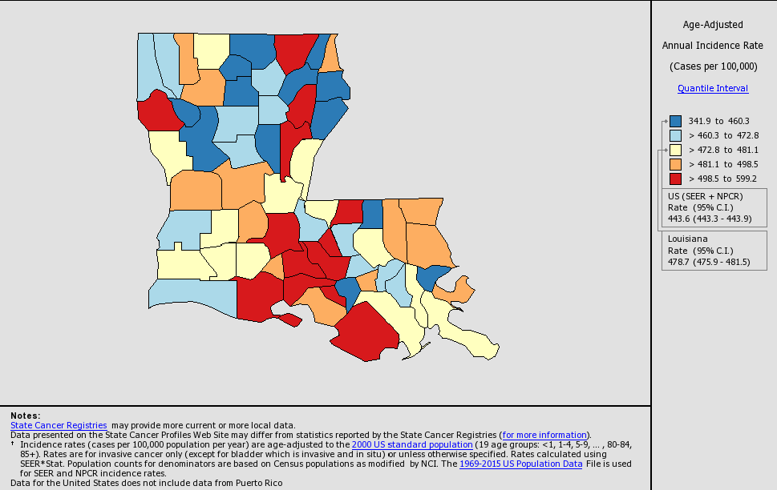
Incidence Rates of All Cancer Sites# in the Louisiana, All Races, Both Sexes, 2010-2014
# Included all invasive cases and bladder in situ cases except squamous cell carcinoma of skin.

Slide 9
All Cancer Sites Incidence ^{#,1,2,} by Region³: Louisiana, Whites, 2010-2014
Rate Per 100,000
# Included all invasive cases and bladder in situ cases except squamous cell carcinoma of skin.
¹ Age-adjusted to the 2000 U.S. standard population.
² Data source for U.S. was the 18 SEER registries.
³ See Appendix A.
* Incidence rate of regions/Louisiana is significantly different from that of U.S.

Slide 10
All Cancer Sites Incidence ^{#,1,2,} by Region³: Louisiana, Blacks, 2010-2014
Rate Per 100,000
# Included all invasive cases and bladder in situ cases except squamous cell carcinoma of skin.
¹ Age-adjusted to the 2000 U.S. standard population.
² Data source for U.S. was the 18 SEER registries.
³ See Appendix A.
* Incidence rate of regions/Louisiana is significantly different from that of U.S.

Slide 11
All Cancer Sites: Trends of Incidence Rates ^{#,1,2,},Whites,1988-2014
Rate per 100,000
Year of Diagnosis
# Included all invasive cases and bladder in situ cases except squamous cell carcinoma of skin.
¹ Age-adjusted to the 2000 U.S. standard population.
² U.S. data source: 18 SEER registries.

Slide 12
All Cancer Sites: Trends of Incidence Rates ^{#,1,2}, Blacks 1988-2014
Rate Per 100,000
Year of Diagnosis
# Included all invasive cases and bladder in situ cases except squamous cell carcinoma of skin.
¹ Age-adjusted to the 2000 U.S. standard population.
² U.S. data source: 18 SEER registries.

Slide 13
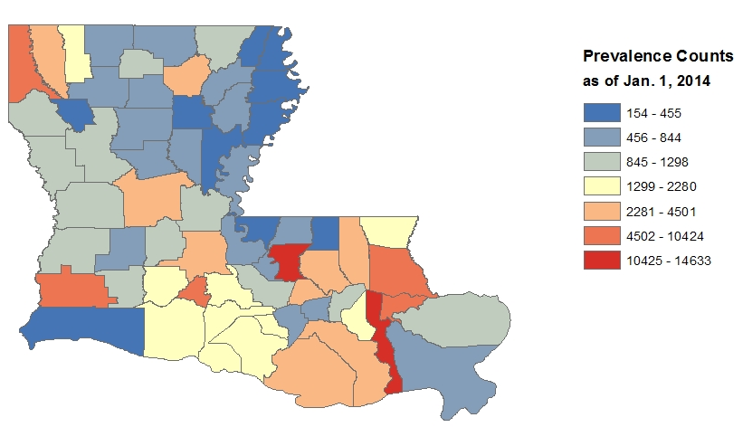
All Cancer Sites#: Prevalence Counts* by Parish, Louisiana
# Included all invasive cases and bladder in situ cases except squamous cell carcinoma of skin.
* 14-year (01/01/2000 - 01/01/2014) limited duration prevalence counts are calculated by National Cancer Institute SEER*Stat software (version 8.3.2).

Slide 14
Common Cancers with Highest Mortality Rate¹ in Louisiana, 2010-2014
1. Data source: NCI state cancer profile

Slide 15
All Cancer Sites: Mortality Rates¹ Louisiana vs. U.S. ², 2010-2014
Rate Per 100,000
¹ Age-adjusted to the 2000 U.S. standard population.
² Mortality data source was National Center of Health Statistics (NCHS).
↓↑Rate of Louisiana is significantly different from that of the U.S.

Slide 16
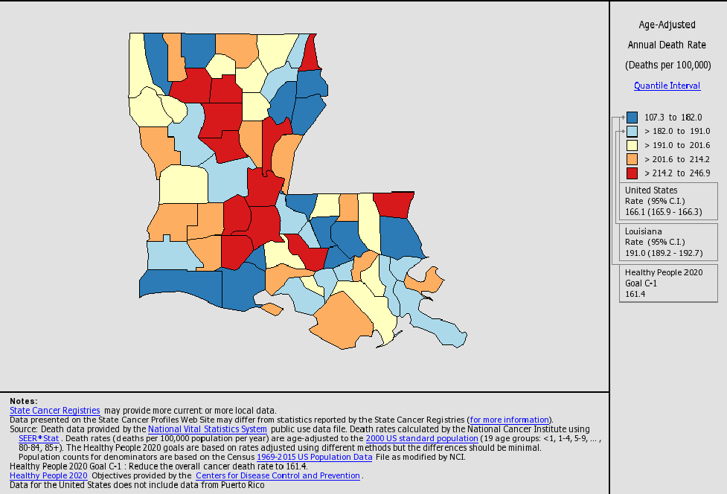
Mortality Rates of All Cancer Sites in Louisiana, All Races, Both Sexes, 2010-2014

Slide 17
All Cancer Sites: Trends of Mortality Rates^{1,2}, Whites, 1988-2014
Rate Per 100,000
Year of Death
¹ Age-adjusted to the 2000 U.S. standard population.
² Data source: National Center of Health Statistics (NCHS).

Slide 18
All Cancer Sites: Trends of Mortality Rates^{1,2}, Blacks, 1988-2014
Rate Per 100,000
Year of Death
¹ Age-adjusted to the 2000 U.S. standard population.
² Data source: National Center of Health Statistics (NCHS).

Slide 19
All Cancer Sites: Louisiana 1988-2014: Trends of Incidence # and Mortality Rates by Gender
Rate per 100,000
Year of Diagnosis/Death
Annual average percent change (APC) were calculated using weighted least squares method.
* APC significantly different from zero.
#Invasive cases only.

Slide 20
All Cancer Sites: Louisiana 1988-2014: Trends of Incidence# and Mortality Rates by Race
Rate per 100,000
Year of Diagnosis/Death
Annual average percent change (APC) were calculated using weighted least squares method.
* APC significantly different from zero.
# Invasive cases only.

Slide 21
All Cancer Sites #: Louisiana 5-Year Relative Survival by Stage¹, White Males, 2007-2013
Percent of Cases by Stage
5-year Relative Survival Rate (%)
# Included all invasive cases except squamous cell carcinoma of skin.
¹ The stage distribution is based on Summary Stage 2000.

Slide 22
All Cancer Sites#: Louisiana 5-Year Relative Survival by Stage¹, White Females, 2007-2013
Percent of Cases by Stage
5-year Relative Survival Rate (%)
# Included all invasive cases except squamous cell carcinoma of skin.
¹ The stage distribution is based on Summary Stage 2000.

Slide 23
All Cancer Sites#: Louisiana 5-Year Relative Survival by Stage¹, Black Males, 2007-2013
Percent of Cases by Stage
5-year Relative Survival Rate (%)
# Included all invasive cases except squamous cell carcinoma of skin.
¹ The stage distribution is based on Summary Stage 2000.

Slide 24
All Cancer Sites#: Louisiana 5-Year Relative Survival by Stage¹, Black Females, 2007-2013
Percent of Cases by Stage
5-year Relative Survival Rate (%)
# Included all invasive cases except squamous cell carcinoma of skin.
¹ The stage distribution is based on Summary Stage 2000.

Slide 25
Appendix A. Regions of the Louisiana Tumor Registry
Regional Registry | Beginning Date of the Registry | Average Annual Population, 2010-2014 | Parishes Covered
Region 1 –New Orleans | 1974 | 21,864 | Jefferson, Orleans, St. Bernard
Region 2 – Baton Rouge | 1983 | 23,410 | Ascension, Assumption, East Baton Rouge, East Feliciana, Iberville, Livingston, Pointe Coupée, St. Helena, Tangipahoa, West Baton Rouge, West Feliciana
Region 3 – Southeast Louisiana | 1983 | 17,036 | Lafourche, Plaquemines, St. Charles, St. James, St. John, St. Tammany, Terrebonne, Washington
Region 4 – Acadiana | 1983 | 17,032 | Acadia, Evangeline, Iberia, Lafayette, St. Landry, St. Martin, St. Mary, Vermilion
Region 5 – Southwest Louisiana | 1983 | 7,698 | Allen, Beauregard, Calcasieu, Cameron, Jefferson Davis
Region 6 – Central Louisiana | 1988 | 8,283 | Avoyelles, Catahoula, Concordia, Grant, La Salle, Rapides, Vernon, Winn
Region 7 – Northwest Louisiana | 1988 | 14,817 | Bienville, Bossier, Caddo, Claiborne, De Soto, Natchitoches, Red River, Sabine, Webster
Region 8 – Northeast Louisiana | 1988 | 9,061 | Caldwell, East Carroll, Franklin, Jackson, Lincoln, Madison, Morehouse, Ouachita, Richland, Tensas, Union, West Carroll
Entire State | 1988 | 119,201
Source: U.S. Bureau of Census and National Cancer Institute, April 2017.

Slide 26
Data Sources
Surveillance, Epidemiology, and End Results (SEER) Program (www.seer.cancer.gov) SEER*Stat Databases, National Cancer Institute, DCCPS, Surveillance Research Program, Surveillance Systems Branch, released April 2017, based on the November 2016 submission.
For Incidence:
Incidence - SEER 18 Regs Research Data + Hurricane Katrina Impacted Louisiana Cases, Nov 2016 Sub (2000-2014) <Katrina/Rita Population Adjustment>
For Mortality:
mortality – All COD, Aggregated With State, Total U.S. (1969-2014) <Katrina/Rita Population Adjustment>>
For Survival:
Incidence - SEER 18 Regs Research Data + Hurricane Katrina Impacted Louisiana Cases, Nov 2016 Sub (1973-2013 varying)

Slide 27
Data Sources
USCS:
U.S. Cancer Statistics Working Group. United States Cancer Statistics: 1999-2014 Incidence and Mortality Web-based Report. Atlanta: U.S. Department of Health and Human Services, Centers for Disease Control and Prevention and National Cancer Institute; 2017. Available at: www.cdc.gov/uscs.
Cancer facts & figures
American Cancer Society. Cancer Facts & Figures 2017. Atlanta: American Cancer Society; 2017.

Slide 28
Data Sources
NCI State profiles
Incidence Data Sources:
Incidence data are provided by the National Program of Cancer Registries External Web Site Policy Cancer Surveillance System (NPCR-CSS), Centers for Disease Control and Prevention and by the National Cancer Institute's Surveillance, Epidemiology, and End Results (SEER) Program External Web Site Policy.
Population counts for denominators are based on Census populations as modified by NCI.
Rates are calculated using SEER*Stat External Web Site Policy.
Mortality Data Sources:
Mortality data are provided by the National Vital Statistics System External Web Site Policy at the National Center for Health Statistics of the Centers for Disease Control and Prevention.
Population counts for denominators are based on Census populations as modified by NCI..
Rates are calculated using SEER*Stat External Web Site Policy.
Trends are determined by using Joinpoint External Web Site Policy analysis of available historical data and reporting the last segment as the most recent trend.

Slide 29
Acknowledgements
Hospital cancer registries (http://louisianatumorregistry.lsuhsc.edu/)
Louisiana Cancer Registrars’ Association (http://www.lcra-usa.org/)
Physicians and staff members in:
Medical records offices
Pathology laboratories
Physician offices and clinics
Hospice programs and nursing homes
Regional and central offices of the Louisiana Tumor Registry (http://louisianatumorregistry.lsuhsc.edu/regionalregistries.html)
School of Public Health, LSU Health Sciences Center–New Orleans
Louisiana Cancer and Lung Trust Fund Board
Coroners’ offices

Slide 30
Sources of LTR Funding
National Cancer Institute, SEER Program
Centers for Disease Control and Prevention (CDC), National Program of Cancer Registries (NPCR)
Louisiana Health Care Services Division

Slide 31
Editors
Yaling Li, BS
Yong Yi, PhD, MS
Lauren Maniscalco, MPH
Meichin Hsieh, PhD, MSPH, CTR
Xiaocheng Wu, MD, MPH, CTR
Contributors
Brent Mumphrey, BS
Tina Lefante, MPH
Lisa Pareti, BS, RHIT, CTR

Slide 32
Questions?
Contact:
LTR-info@lsuhsc.edu
or
504/568-5757

